Slide 1
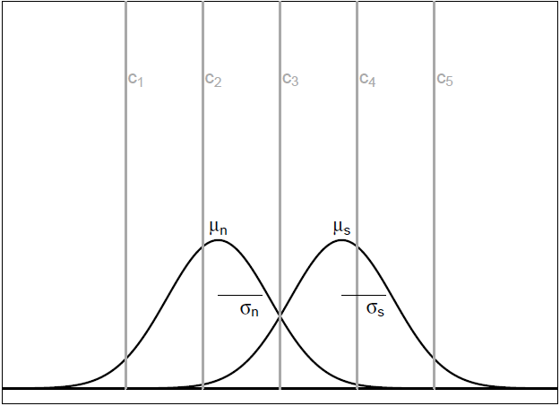
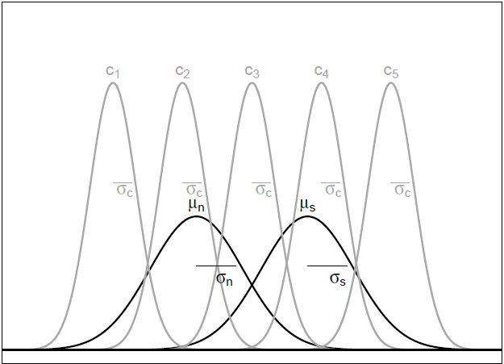
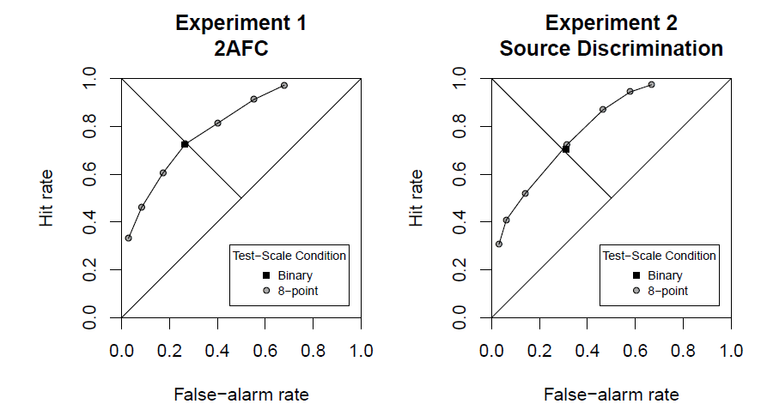
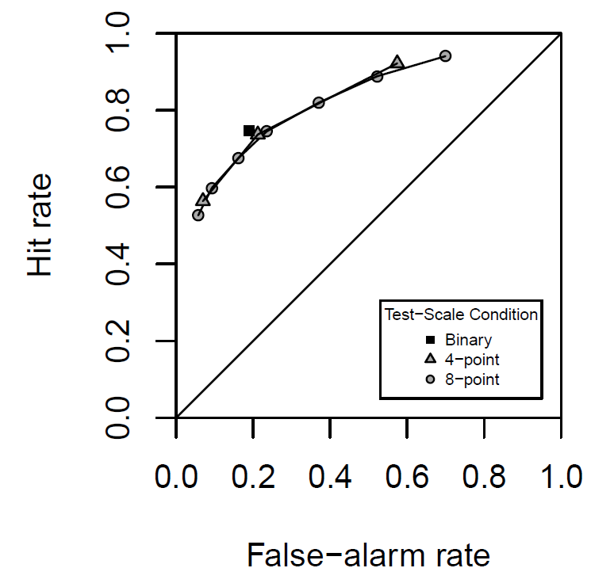
The Impact of Criterion Noise in Signal Detection Theory:
An Evaluation across Recognition Memory Tasks
Julie Linzer David Kellen Henrik Singmann Karl Christoph Klauer
Albert-Ludwigs-Universität Freiburg
Background
Experiments
Signal Detection Theory (SDT, Green & Swets, 1966) is the most prominent and
successful measurement model in recognition memory. According to SDT, studied and non-studied items vary in terms of familiarity values, which are compared with fixed response criteria in producing recognition judgments (for a depiction of the model see Figure 1).
EXPERIMENT 1: two-alternative forced choice task
Participants. 60 students (mean age = 21.98, SD = 2.1, ranging from 18 to 28 years)
Design and Procedure. The computer-based experiment consisted of a single study phase followed by a single test phase.
Study phase: 316 words, presented in black over grey background for 1200ms each, with a 200 ms inter-stimulus interval (ISI).
Test phase: two-alternative forced choice task; two test-scale conditions: binary and 8-point scale
old Item new Item
"left" "right”
old Item new Item
"sure left" ++++ +++ ++ + + ++ +++ ++++ "sure right"
EXPERIMENT 2: source discrimination task
Participants. 47 students (mean age = 21.28, SD = 1.9, ranging from 18 to 29 years).
Study phase. 160 words (90 Source A and 90 Source B items), presented for 2000ms each (250 ms ISI). Source A items were presented in red on the left side of the screen and Source B items in green on the right side of the screen.
Test phase. source discrimination task (only old words tested), same test conditions as in Experiment 1
Figure 1: Left Panel: Representation of the standard SDT model with mean μ_{n} (μ_{s}) and standard deviation σ_{n} (σ_{s}) of the signal distribution (noise distribution). c₁, c₂,c₃,c₄,c₅ depict different response criteria. Right Panel: Representation of the SDT model with criterion noise (σ_{c}).
Results
A recent debate has questioned the assumption that response criteria are fixed, and a number of researchers have argued that response-criteria positions vary substantially across trials. Such criterion noise has the potential of severely distorting the characterization of the data via standard SDT models.
Benjamin, Tullis and Lee (2013) found that recognition-memory performance estimates based on responses to rating scales with many options (e.g, an 8-point confidence scale) were lower than estimates obtained with scales with fewer options (e.g., binary responses), a result that is predicted given criterion noise (for a depiction of the aggregate data confidence-rating ROCs as well as the binary-condition's hit and false-alarm rates see Figure 2).
However, there are problematic aspects in Benjamin et al.’s analysis that suggest that the evidence for criterion noise was overstated (see Kellen, Singmann, Klauer & Flade, submitted).
Figure 3: Left Panel: Aggregate-data 2AFC ROC from Experiment 1. Hit and false-alarm rates correspond to the rate of "Right" responses to old-right and old-left trials, respectively. Right Panel: Aggregate-data source-discrimination ROC from Experiment 2. Hit and false-alarm rates correspond to the rate of "Source A" responses to source-A and source-B items, respectively.
The median d’ estimates were 1.22 in both scale conditions in Exp. 1, and both 1.07 in Exp. 2. Not surprisingly, no significant differences were found (smallest
p =. 70, largest Bayes Factor (alt/null) = 0.21). The d’ estimates were correlated across conditions in both experiments (smallest r = 0.65, p <.001).
Conclusions
In both experiments, no differences in performance were found between the binary and 8-point scale condition. This result is at odds with Benjamin et al.’s prediction of a performance decrease in the 8-point condition.
This result joins previous failures to demonstrate the contribution of criterion noise (Kellen et al., 2012).
→ The standard SDT model is a suitable measurement model, whose characterization of recognition judgments is not compromised by unaccounted criteria variability.
Figure 2: Aggregate-Data (uncorrected frequencies) Yes-No ROC from Benjamin et al. (2013). Hit rates correspond to “Yes" responses to old items and “No” responses to new items. False-alarm rates correspond to “No” responses to old items and “Yes” responses to new items.
We conducted two experiments, that built upon Benjamin et al.’s (2013) approach. In order to directly compare the performance measures across conditions, we used two different memory tasks in which symmetrical
ROC-curves are expected. In this case, the d´ measure becomes a suitable way of summarizing memory performance.
References
Benjamin, A. S., Tullis, J. G., & Lee, J. H. (2013). Criterion noise in ratings-based recognition: Evidence from the effects of response scale length on recognition accuracy. Journal of Experimental Psychology: Learning, Memory, and Cognition, 39, 1601-1608.
Green, D. M., & Swets, J. A. (1966). Signal detection theory and psychophysics. New York: Wiley.
Kellen, D., Klauer, K. C., & Singmann, H. (2012). On the measurement of criterion noise in signal detection theory: the case of recognition memory. Psychological Review, 119, 457-479.
Kellen, D., Singmann, H., Klauer, K. C., & Flade, F. (submitted). The Impact of Criterion Noise in Signal Detection Theory: An Evaluation across Recognition Memory Tasks.

