Slide 1
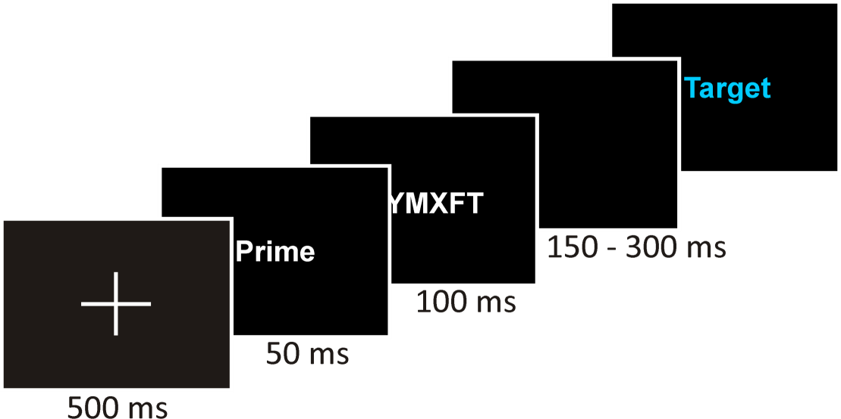
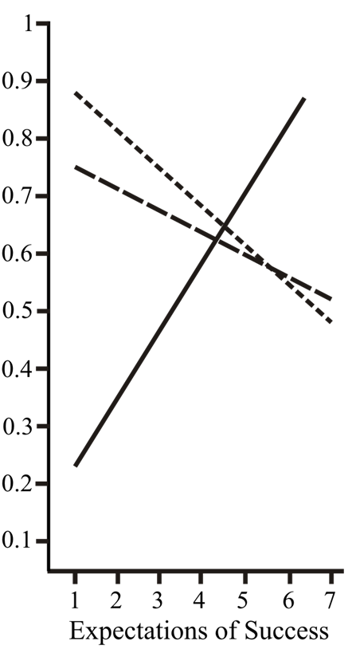
Mental Contrasting Effects on Behavior Mediated by Reality-Means Associations
Henrik Singmann^{1,2,}*, Andreas Kappes², & Gabriele Oettingen^{2,3}
¹ University of Freiburg ² University of Hamburg ³ New York University
Introduction
Research on the self-regulation of goal-setting examines how people set themselves binding goals: by mentally contrasting a desired future with the reality (i.e., mental contrasting; Oettingen et al., 2001). Specifically, when expectations of success are high, mental contrasting leads to strong goal commitments; when expectations of success are low, mental contrasting leads to weak goal commitments (overview: Oettingen & Kappes, 2008).
After mental contrasting paired with high expectations people report insights into what they need to do to achieve their desired futures (Adriaanse et al., in press). One crucial indicator for insights is that people immediately know what they need to do (Davidson, 2003). In the case of mental contrasting people should immediately know which behavioral means are critical for overcoming obstacles inherent in reality. Such behavioral insights would express themselves in associations between the reality and behavioral means useful for overcoming obstacles inherent in reality in order to reach the desired future (i.e., reality-means associations). Such associations suggest the activation of the relevant behavior when the obstacles inherent in reality are encountered.
In contrast, other self-regulatory strategies of goal setting such as contrasting the reality with the desired future (i.e., reverse contrasting) do not lead to insights into what needs to be done. Hence, no associations between the obstacles inherent in reality and behavioral means should be established.
We examined if mental contrasting affects associations between the reality and goal-relevant means (i.e., reality-means associations) in line with one’s expectations of success. Further, we tested if these associations predict the use of the behavioral means when the obstacle inherent in reality is encountered.
Methods
Participants: 126 University of Hamburg students
Overview: The study consisted of four parts
Introduction of the cover story
Induction of experimental conditions (the IV)
LDT to measure reality-means associations (the mediator)
Assessment of stair use (the DV)
Procedure:
The cover story explained in vivid detail that it is desirable for students to become fitter (i.e., desired future), that inconvenience stands in the way of the desired future (i.e., reality) and that exercise, especially taking the stairs instead of the elevator, is an appropriate means for reaching the desired future (i.e., goal-relevant means): “Students like you who managed to take the stairs instead of the elevator on a daily basis reported feeling fitter permanently.”
- Participants were asked to indicate their expectations of success (i.e., “How likely do you think it is that you will improve your fitness? “) - Participants were asked to name the desired future (i.e., aspect associated with becoming fit)
2. Participants elaborated:
Mental contrasting: Participants elaborated about the desired future (i.e., the named aspect associated with becoming fit), then they elaborated about inconvenience.
Reverse contrasting (control for content): Participants elaborated the exact same content as the mental contrasting condition, but in reversed order.
Control condition (control for order of affect): Participants elaborated a positive experience with one of their professors, followed by a negative experience with one of their professors.
Methods (continued)
3. We used a sequential priming paradigm with a lexical decision task (LDT) to measure the reality-means associations (sample trial →):
Critical trials: reality-means association elevator – exercise accessibility xxxxxx – exercise
To measure if participants used the stairs instead of the elevator we asked participants to leave the experimental room to complete the next part of the study three floors down. We observed via video camera if participants on their way down and back up used the stairs.
After coming back, participants were thanked and debriefed.
Results (continued)
Effect of Expectations on Reality-Means Association (Mediator)
A GLM with expectations and condition on the reality-means associations (controlling for means accessibility), revealed the expected interaction: F(2,117) = 6.7, p = .07.
Only in the mental contrasting condition expectations predicted reality-means associations (r = -.44, p < .01). This correlation was not significant in the control conditions (rs < .17, ns).
Mediated Effect of Expectations on Stair Use
The mediation analyses is restricted to the mental contrasting condition.
(The reality-means association was controlled for accessibility of the means)
Mediation analyses revealed a significant reduction of the direct effect of expectations of success on stair use after entering reality-means association (95% CI = .01 - .09; Preacher & Hayes, 2008).
Reality-Means Associations
Mental Contrasting
n = 45
Reverse Contrasting
n = 43
Control Group
n = 38
Results
Effect of Expectations on Stair Use (DV)
We formed an overall index of stair use (0 = both ways elevator, .5 = one way stairs, …)
A GLM with expectations and condition on stair use confirmed the predicted interaction , F(2,120) = 3.23, p = .04.
Only in the mental contrasting condition expectations predicted stair use (r = .32, p = .03). This correlation was not significant in the control conditions (|r|s < .21; ns).
-.32*
-.33*
Expectations
.21, p = .16
Stair-Use
1. Desired
Future
1. Incon-venience
1. Positive Experience
.32*
The Present Research
Overview: We told students that in order to become fitter (i.e., desired future), they need to overcome their inconvenience (i.e., reality aspect) in daily life. Small steps such as taking the stairs instead of the elevator (i.e., goal-relevant means) are sufficient to reach the desired future of becoming fitter. Next, all students indicated expectations of successfully improving their fitness. Then, three experimental conditions were established: mental contrasting versus two control conditions. Next, all participants performed a lexical decision task measuring the reality-means associations. Finally, we sent participants three floors down for an alleged additional part of the study and observed if they took the stairs (i.e., implemented the goal-relevant means).
Main Hypotheses: In the mental contrasting condition, we predicted a mediation of the effect of expectations on stair-use by reality-means associations.
2. Incon-venience
2. Desired Future
2. Negative Experience
Index of Stair-Use
Conclusion
Mental contrasting effects on stair-use were mediated by reality-means associations.
This finding implies that mental contrasting paired with high expectations leads to insights on how to overcome obstacles inherent in reality. Furthermore, these insights help people to act accordingly.
* Contact:
henrik.singmann@psychologie.uni-freiburg.de
Poster presented at the 11th Annual Meeting of the Society for Personality and Social Psychology, Las Vegas, NV, January 2010

