Slide 1
Comparing Models of Probabilistic Conditional Reasoning: Evidence for an Influence of Logical Form
Henrik Singmann
Karl Christoph Klauer
Sieghard Beller

Slide 2
Conditional Reasoning
Conditional is a rule with form: If p then q.
Conditional inferences usually consist of conditional rule (major premise), minor premise (e.g., p), and conclusion (e.g., q). e.g.:
If a person drinks a lot of coke then the person will gain weight.
A person drinks a lot of coke.
Conclusion: The person will gain weight.

Slide 3
4 Conditional Inferences
Modus Ponens (MP):
If p then q.
p
Conclusion: q
Affirmation of the consequent (AC):
If p then q.
q
Conclusion: p
Modus Tollens (MT):
If p then q.
Not q
Conclusion: Not p
Denial of the antecedent (DA):
If p then q.
Not p
Conclusion: Not q

Slide 4
4 Conditional Inferences
Modus Ponens (MP):
If p then q.
p
Conclusion: q
Affirmation of the consequent (AC):
If p then q.
q
Conclusion: p
Modus Tollens (MT):
If p then q.
Not q
Conclusion: Not p
Denial of the antecedent (DA):
If p then q.
Not p
Conclusion: Not q
valid in standard logic (i.e., truth of premises entails truth of conclusion)
NOT valid in standard logic (i.e., truth of premises does NOT entail truth of conclusion)

Slide 5
Research Question:
Effect of presence of conditional in everyday probabilistic conditional reasoning?

Slide 6
Example Item: Knowledge Phase
Observation: A balloon is pricked with a needle.
How likely is it that it will pop?

Slide 7
Example Item: Knowledge Phase
Observation: A balloon is pricked with a needle.
How likely is it that it will pop?
X

Slide 8
Example Item: Rule Phase
Rule: If a balloon is pricked with a needle, then it will pop.
Observation: A balloon is pricked with a needle.
How likely is it that it will pop?

Slide 9
Example Item: Rule Phase
Rule: If a balloon is pricked with a needle, then it will pop.
Observation: A balloon is pricked with a needle.
How likely is it that it will pop?
X

Slide 10
Klauer, Beller, & Hütter (2010): Experiment 1 (n = 15)
error bars: difference adjusted Cousineau-Morey-Baguley intervals
different lines: different conditionals (i.e., different contents/items)
conditional absent
conditional present

Slide 11
Klauer, Beller, & Hütter (2010): Experiment 1 (n = 15)
error bars: difference adjusted Cousineau-Morey-Baguley intervals
different lines: different conditionals (i.e., different contents/items)
↑ conditional absent ↓
↑ conditional present ↓
new data (n = 29)

Slide 12
Klauer, Beller, & Hütter (2010): Experiment 1 (n = 15)
error bars: difference adjusted Cousineau-Morey-Baguley intervals
different lines represent different contents of the conditional
Presence of conditional increases participants' estimates of probability of conclusion.
Especially for formally valid inferences MP and MT.
↑ conditional absent ↓
↑ conditional present ↓
new data (n = 29)

Slide 13
Klauer, Beller, & Hütter (2010): Experiment 1 (n = 15)
error bars: difference adjusted Cousineau-Morey-Baguley intervals
different lines represent different contents of the conditional
How can we explain effect of presence of conditional? Our data challenge pure Bayesian or probabilistic approaches that solely rely on background knowledge.
↑ conditional absent ↓
↑ conditional present ↓
new data (n = 29)

Slide 14
Example Item: Knowledge Phase
Observation: A balloon is pricked with a needle.
How likely is it that it will pop?
X

Slide 15
The Knowledge Phase
Participants estimate conclusion given minor premise only, e.g., Given p, how likely is q?
Response should reflect conditional probability of conclusion given minor premise, e.g., P(q|p)
"Inference" | "MP" | "MT" | "AC" | "DA"
 | p ∴ q | ¬q ∴ ¬p | q ∴ p | ¬p ∴ ¬q
Response reflects | P(q|p) | P(¬p|¬q) | P(p|q) | P(¬q|¬p)

Slide 16
Formalizing the Knowledge Phase
Joint probability distribution over P(p), P(q), and their negations per content:
Provide the conditional probabilities, e.g.: P(MP) = P(q|p) = P(p ∧ q) / P(q)
Three independent parameters describe joint probability distribution (e.g., P(p), P(q), and P(¬q|p), Oaksford, Chater, & Larkin, 2000).
 | q | ¬q
p | P(p ∧ q) | P(p ∧ ¬q)
¬p | P(¬p ∧ q) | P(¬p ∧ ¬q)

Slide 17
How do we explain the effect of the conditional?
Dual-source model for probabilistic conditional inferences (Klauer, Beller, & Hütter, 2010):
Conditional absent (knowledge phase) Conditional probability of conclusion given minor premise (from background knowledge). E.g., Given p, how likely is q? P(q|p)
Conditional present (rule phase) Conditional adds form-based evidence: Subjective probability to which inference is seen as warranted by (logical) form of inference. E.g., How likely is the conclusion given that the inference is MP?

Slide 18
How do we explain the effect of the conditional?
Dual-source model for probabilistic conditional inferences (Klauer, Beller, & Hütter, 2010):
Conditional absent (knowledge phase) Conditional probability of conclusion given minor premise (from background knowledge). E.g., Given p, how likely is q? P(q|p)
Conditional present (rule phase) Conditional adds form-based evidence: Subjective probability to which inference is seen as warranted by (logical) form of inference. E.g., How likely is the conclusion given that the inference is MP?
Our intuition:
Conditional provides form-based information which is integrated with background knowledge.

Slide 19
Formalizing the Dual-Source Model
knowledge-based
+
ξ(C,x)
τ(x) + (1 – τ(x)) × ξ(C,x)
Response
× λ
× (1 – λ)
form-based
C = content (1 – 4)
x = inference (MP, MT, AC, & DA)

Slide 20
How else explain effect of conditional?
Alternative (Bayesian) views:
New paradigm psychology of reasoning (e.g., Oaksford & Chater, 2007; Pfeifer & Kleiter, 2010)
Causal Bayes nets (e.g., Sloman, 2005; Fernbach & Erb, in press)
Reasoning basically probability estimation from coherent probability distribution of background knowledge.
Presence of conditional changes knowledge base: Form affects each item idiosyncratically.

Slide 21
Model differences
Dual-Source Model
Alternative Views
Rule Phase:
Knowledge Phase +
Form-based evidence per inference (+ 4 parameters)
Knowledge Phase:
Probability distribution over P(p), P(¬p), P(q), P(¬q) per content.
Rule Phase:
Probability distribution per content/conditional updates:
P'(¬q|p) < P(¬q|p) (Oaksford, Chater & Larkin, 2000)
P'(q|p) > P(q|p), then minimizing KL-distance to prior distribution (Hartmann & Rafiee Rad, 2012)

Slide 22
Research Question:
Which model provides the best account to the data?

Slide 23
The Data Sets
Data sets (or parts thereof) that implement default paradigm:
Knowledge phase without conditional.
Rule phase with conditional.
No additional manipulations.
6 datasets (N = 148):
Klauer et al. (2010, Exps. 1 & 3, n = 15 & 18) and 2 new data sets (n = 26 & 29) exactly implemented default paradigm. (For Klauer et al.'s experiments third sessions were omitted)
For Klauer et al. (2010, Exp 4, n = 13) we omitted trials which did not follow default paradigm.
New data set (n = 47) in which speaker expertise was manipulated (Experiment 2, Part I)

Slide 24
General Methodology
4 different conditionals (i.e., contents)
Participants responded to all four inferences per content.
Participants gave two estimates per inference: original and converse inference (pooled for analysis).
Two measurements (> one week in between):
without conditional
with conditional
→ 32 data points per participant.
Exceptions:
Klauer et al. (2010, Exp. 3): 5 conditionals = 40 data points per participant
New data on speaker expertise: 6 conditionals (3 experts, 3 novice) = 48 data points

Slide 25
Candidate Models
Fitted all five models to individual data by minimizing sum of squared deviance from data and predictions.
Knowledge Phase (for all models):
3 parameters per content/conditional = 12 parameters for 4 conditionals.
Rule Phase:
Dual-source model (DS): + 4 form-based parameters = 16 parameters (independent of the number of conditionals)
Oaksford et al. (2000, OCL): + 1 parameter per content = 16 parameters.
Extended Oaksford & Chater (2007, eOC & eOC*): + 2 parameters per content = 20 parameters. (eOC* does not restrict posterior probability distribution)
Minimizing the Kullback-Leibler divergence (KL): + 1 parameter per content = 16 parameters

Slide 26
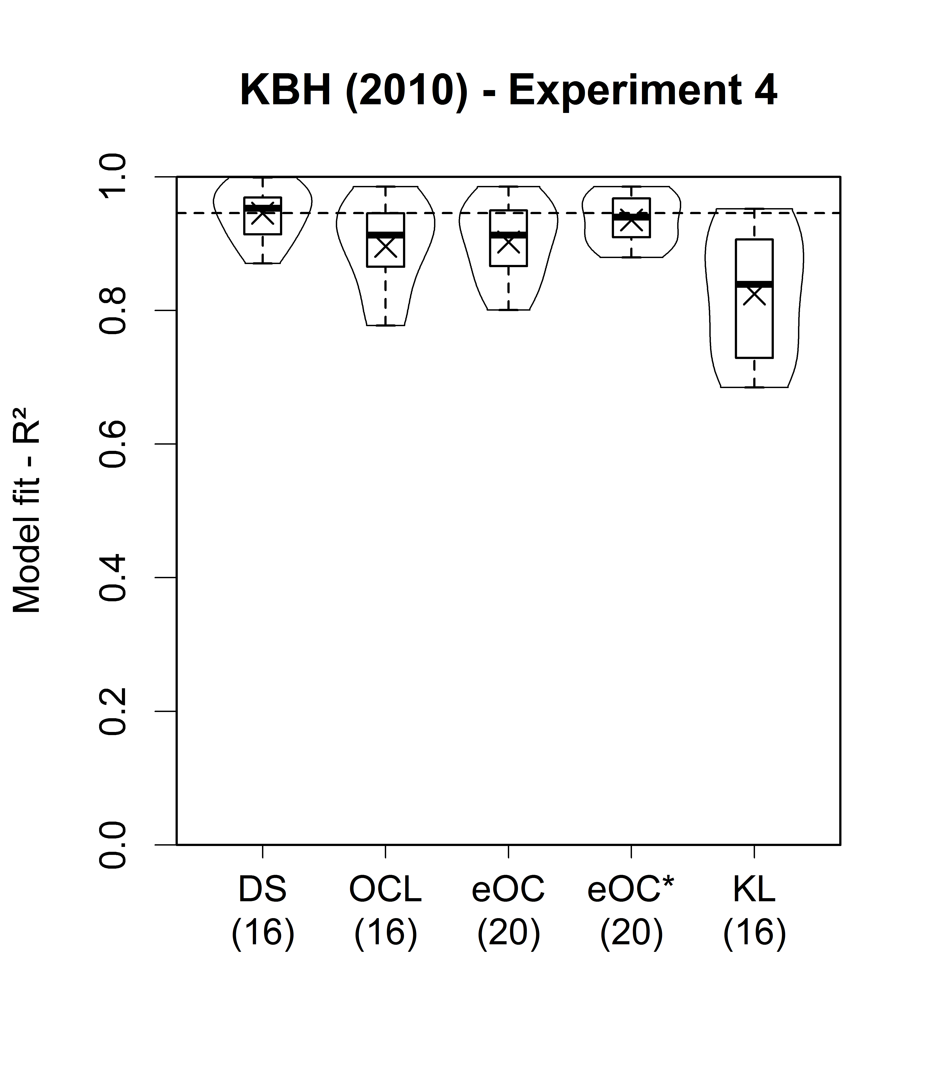
Results I
Klauer et al. (2010), Exp. 4
5 measurement points - we only use data that is comparable to other conditions (spread across 5 measurement points)
Dashed line shows mean fit value of DS.
Numbers behind model names = numbers of parameters per model.
Ordering: DS = eOC* > OCL > KL

Slide 27
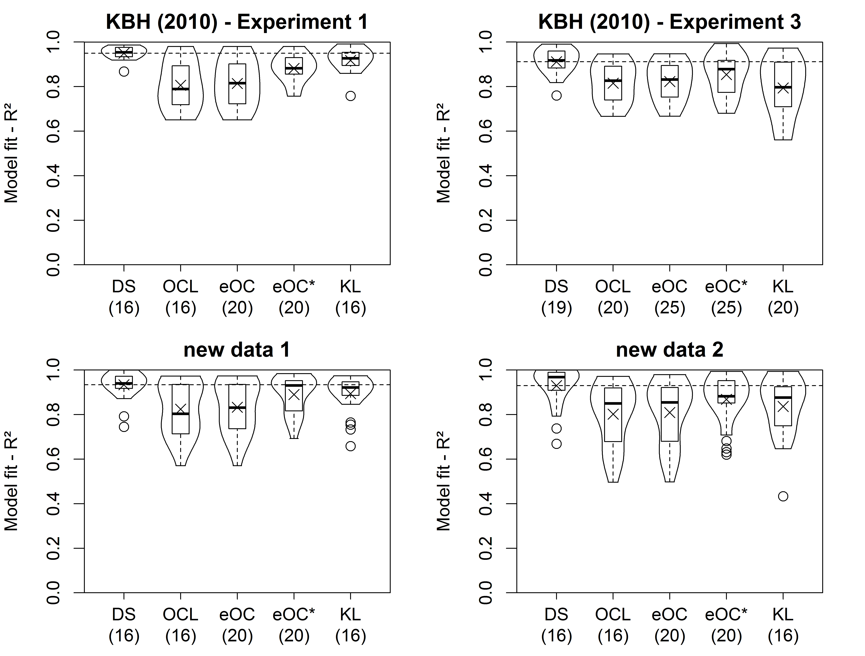

Slide 28
DS > KL > eOC* > OCL
DS > eOC* > OCL = KL
DS > eOC* = KL > OCL
DS > eOC* = KL = OCL

Slide 29
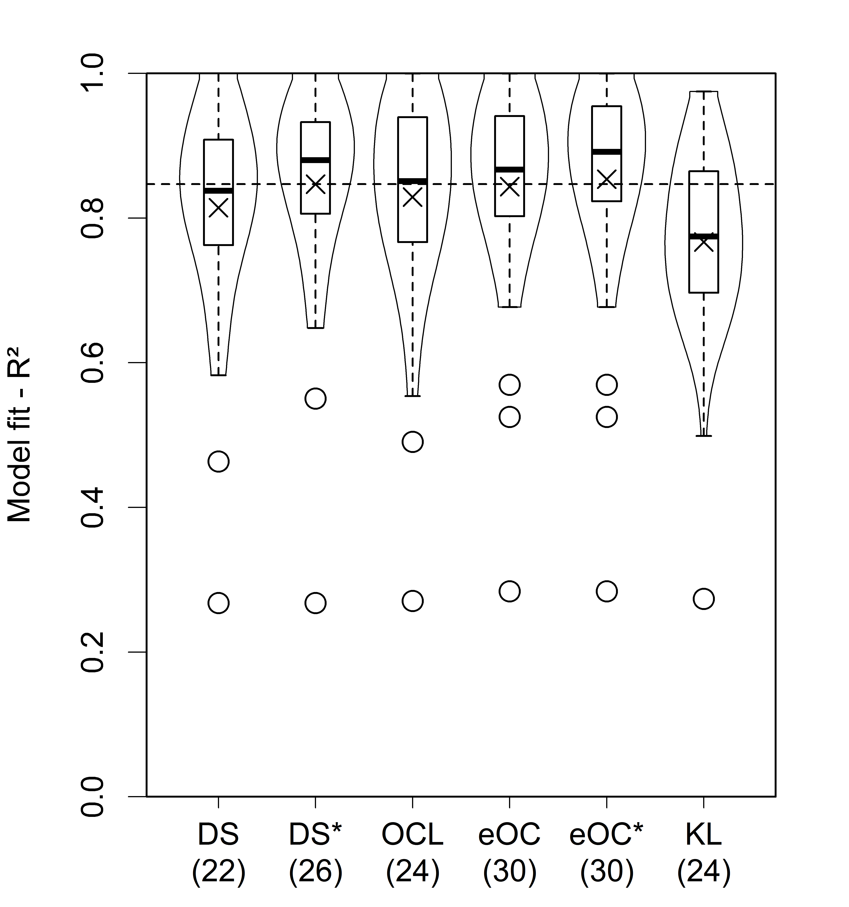
Results Speaker Expertise (Experiment 2)
48 data points.
In addition to DS, we fitted DS* which allowed for separate form parameters for experts and novices, respectively.
Ordering: eOC* = DS* ≥ OCL = DS > KL

Slide 30
Summary
Dual-source model provides overall best account for 6 datasets.
For two cases where it shares the first place (with the extended model by Oaksford & Chater, 2007), it has less parameters
Provides best account for 83 of 148 data sets (56%).
Extended Oaksford & Chater model (48 best accounts) performs better than Kullback-Leibler model (17 best account), but has more parameters.
Strong evidence for our interpretation of conditional: Provide formal information that cannot easily be accounted for by changes in participants' knowledge base only.

Slide 31
General Discussion
(Conditional) Reasoning based on different integrated information: No single-process theory adequate (Singmann & Klauer, 2011).
„Pure“ Bayesianism adequate only for knowledge phase (i.e., without conditional)
Dual-source model is not tied to normative model (e.g., Elqayam & Evans, 2011).
Parameters of dual-source model offer insights into cognitive processes:
Dissociation of suppression effects: disablers decrease weighting parameters, whereas alternatives decrease background-knowledge based evidence for AC and DA (and both affect the form-based component)
Speaker expertise affects weighting parameter only

Slide 32
Thanks for your attention.
Thanks to
Karl Christoph Klauer
Sieghard Beller
Slides are available at my website: http://www.psychologie.uni-freiburg.de/Members/singmann/

