Slide 1
Conditionals and Inferential Connections: A Hypothetical Inferential Theory (HIT)
Henrik Singmann, Igor Douven, Shira Elqayam, David Over, & Janneke van Wijnbergen-Huitink
New paradigm, probabilities, pragmatics, and dual processing: Festschrift in honour of David Over’s 70th birthday

Slide 2
Relation of Antecedent and Consequent in Conditionals
If David Over prefers apples over oranges, Elizabeth Warren will run for president in 2020.
If the price of oil soars in the next years, Winston Churchill did not sleep the night before D-Day.
If global warming continues, then parts of England will be flooded.
1. and 2. seem odd: No apparent relationship between antecedent and consequent.
Main semantics cannot explain this oddness:
conditionals are not truth-functional: mental models, non-propositionalism
truth of conditional function of truth of antecedent and consequent (in actual or possible world): material conditional, defective truth-table/three-value view, Stalnaker, Lewis

Slide 3
Inferentialism
Truth of antecedent and consequent not enough to make conditional true.
For a conditional to be true, we should be able to infer its consequent from its antecedent (e.g., Ramsey, 1929; Kratzer, 1986; Braine & O'Brien, 1991).
Krzyzanowska, Wenmackers, and Douven (2014) propose that inference from antecedent to consequent can be deductive, inductive, or abductive:
If Wilma and Fred are going to the gym together, they have settled their dispute.
If Barney works hard, he will pass the exam with flying colors.
Conditional is true if and only if there exists a strong enough argument leading from antecedent (plus background knowledge) to consequent.

Slide 4
Hypothetical Inferential Theory (HIT)
Hypothetical thinking theory (Evans, 2006, 2007), dual-process theory:
Type 1 processes focus attention on most relevant possibility or (epistemic) mental model (relevance principle), and only one model (singularity principle).
Ensuing mental representation accepted as default (satisficing principle).
Type 2 processes can revise or reject default, in case of good reason against it.
HIT combines inferentialism (Krzyzzanowska et al., 2014) and hypothetical thinking theory.
Default relevant mental representation: inferential relation between antecedent and consequent.
Satisficing principle: link need only be strong enough, in the sense of being subjectively supported.
New prediction:
conditional is judged as true if there is strong enough argument from antecedent to consequent.
conditional is false if argument is weak (or from antecedent to negation of consequent)
conditional is indeterminate if there is no such argument.

Slide 5
Soritical Truth-Table Task
If patch number 6 is green, so is patch number 9.
True
False
Neither true nor false
Guarantees inferential relevance → low rate of indeterminate responses
Allows to manipulate inferential strength.

Slide 6
Soritical Truth-Table Task
If patch number 6 is green, so is patch number 9.
If patch number 6 is green, so is patch number 3.
If patch number 6 is green, so is patch number 5.
If patch number 3 is green, so is patch number 6.
1. vs. 2.: Compared to patch 6, 9 is on "greener" (i.e., congruent), 3 is on "bluer" (i.e., incongruent) side. Inference in 1. is stronger than in 2.: Effect of direction.
2. vs. 3.: Compared to patch 6, 5 is directly adjacent, while 3 is farther away. Inference in 2. is stronger than in 3.: Effect of distance.
1. vs. 4.: Patch 9 is "greener" than patch 6: If connection is inferential, should be affected by inferential biases: Belief bias.

Slide 7
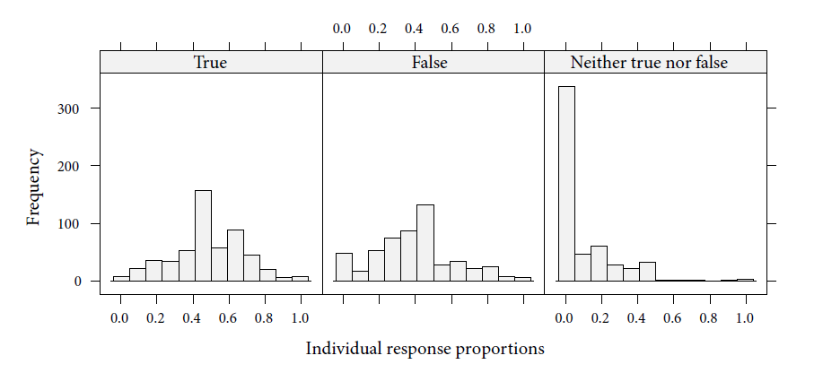
Experiment 1 (N > 500)
22 different conditionals: If patch number X (e.g., 6) is green, so is patch number Y (e.g., 9).

Slide 8
Experiment 1 (N > 500)

Slide 9
Experiment 1 (N > 500)

Slide 10
Experiment 1 (N > 500)
HIT: Direction, distance, consequent
Consequent only: MMT (initial model), three-value view, Lewis
Antecedent-consequent: MMT (fleshed-out), material conditional, Stalnaker

Slide 11
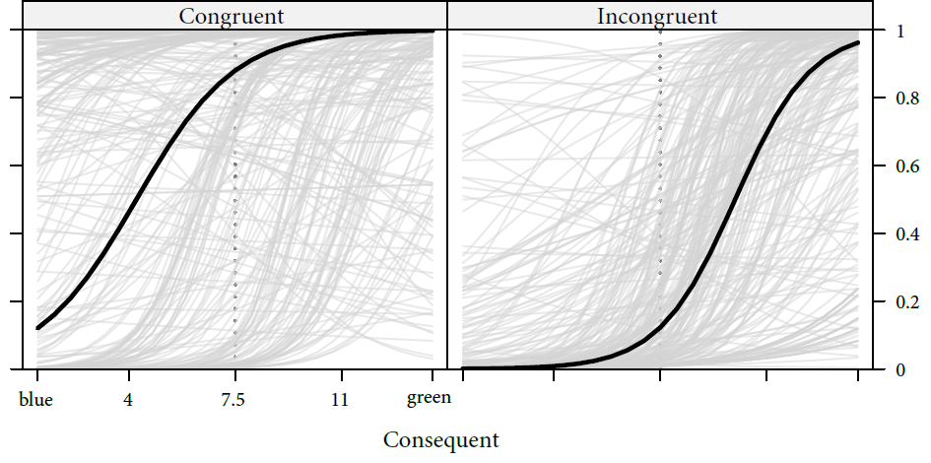
Experiment 1 (N > 500)
Direction × consequent interaction (= validity × believability): stronger consequent effect for weaker inferences!

Slide 12
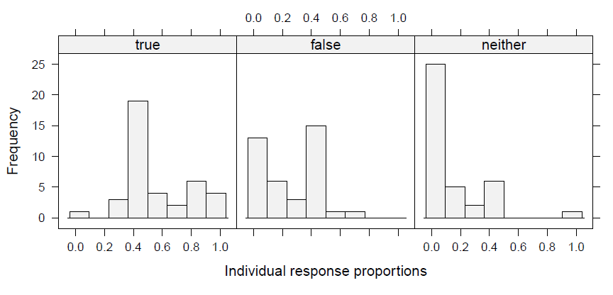
Experiment 2 (N = 39)
If sphere number i (e.g., 6) is large, so is sphere number (e.g., 9).
Instructions clarify that no sphere is actually large, purely relative judgments.

Slide 13
Experiment 2 (N = 39)

Slide 14
Experiment 2 (N = 39)
Direction × distance × consequent interaction (= validity × believability interaction):
Effect of consequence only present for weaker inferences!

Slide 15
Summary
Guaranteed inferential relevance: Low rates of indeterminate responses
Strong effect of inferential variables direction and distance
For soritical color series strong effect of consequent (belief bias), less for soritical series of spheres.
Truth judgments for conditionals affected by inferential considerations: Strong enough inference from antecedent to consequent makes conditional true.
Believability of consequent affects truth judgments, if belief provides strong cue (belief bias analogue).
Experiment 3: Inferential strength and metacognitive confidence explain truth table judgments (partly).

Slide 16
Thank you for your attention. Questions?

Slide 17
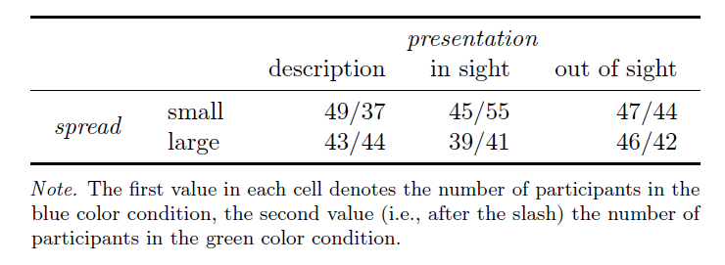
Details Experiment 1 (N = 532)
3 presentation conditions: description, in sight, out of sight
2 spread conditions: small vs. large
2 color conditions: blue vs. green
22 different conditionals: If patch number i is X, so is patch number j.
Where, X in {green, blue}; i in {2, 7, 8, 9, 10, 13}; and j in {i - 3/2, i -1, i + 1, i + 2/3} if possible.

Slide 18
Experiment 1 (N > 500)

