Slide 1
Using Ensembles of Cognitive Models to Answer Substantive Questions
Henrik Singmann
David Kellen
Eda Mızrak
Ilke Öztekin

Slide 2
CogSci: Theory, Data, and Models
Goals:
Develop accurate characterizations of observed behavior in terms of latent cognitive processes.
Describe differences between groups or conditions in terms of latent processes. For example:
Are older adults more risk averse or cautious than younger adults?
Do preschool children exhibit a "yes" response bias to yes/no questions?
Do amnesic patients have both impaired implicit and explicit memory?
Does emotional material elicit differences in memorability or in response bias?
Does low working memory (WM) capacity also affect memory performance for low WM load tasks?
Cognitive measurement models:
For example: Prospect theory, Ratcliff diffusion model, process dissociation procedure, signal detection theory
Instantiate relationship with observed data in clear and general way
Privileged approach for evaluating contribution of latent processes to observed behavior
Ensemble posterior model probabilities combine multiple measurement models for answering substantive questions.

Slide 3
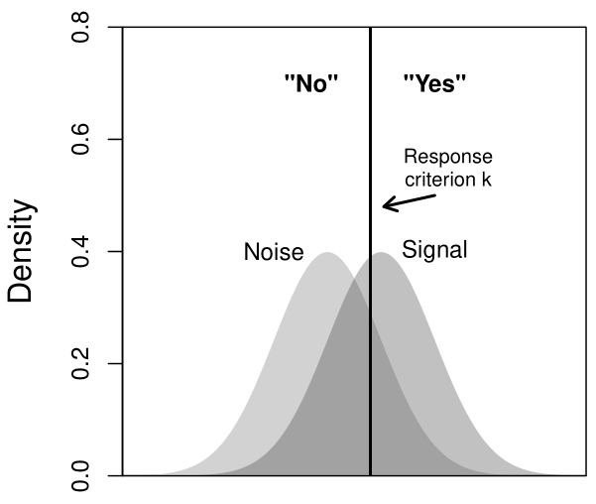
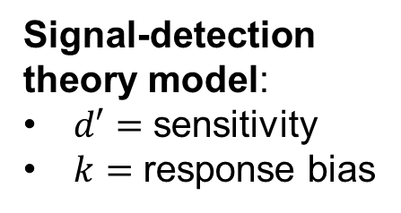
Latent Processes in Detection Experiments
2 independent data points:
Hits: P(T|target)
False alarm: P(T|lure)
Two latent process:
Sensitivity / discriminability: higher sensitivity: ↑ hits; ↓ false alarms
Response bias: stronger bias towards T: ↑ hits; ↑ false alarms
m
Study List
r
b
500 ms each
v
#&#
Signal-detection theory model:
$d′=$ sensitivity
$k=$ response bias
"L"
"T"
v
y
lure
target
T
L
T
L
target
lure
signal strength

Slide 4
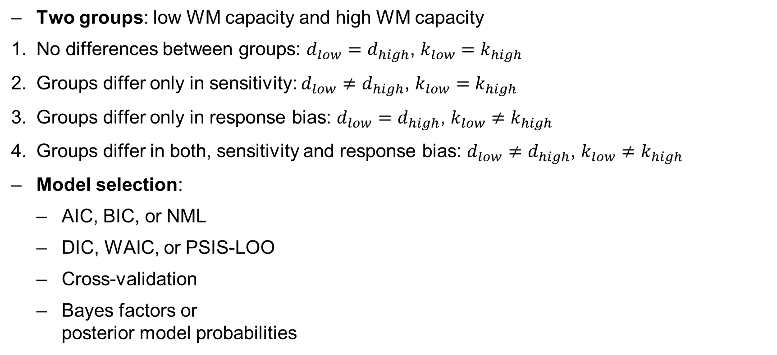
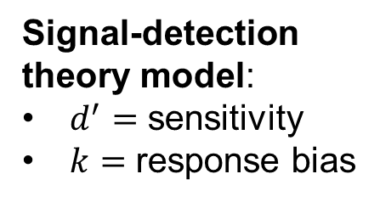
SDT with 2 Groups: 4 Possible Models
Two groups: low WM capacity and high WM capacity
No differences between groups: $d_{low}=d_{high}$, $k_{low}=k_{high}$
Groups differ only in sensitivity: $d_{low}≠d_{high}$, $k_{low}=k_{high}$
Groups differ only in response bias: $d_{low}=d_{high}$, $k_{low}≠k_{high}$
Groups differ in both, sensitivity and response bias: $d_{low}≠d_{high}$, $k_{low}≠k_{high}$
Model selection:
AIC, BIC, or NML
DIC, WAIC, or PSIS-LOO
Cross-validation
Bayes factors or posterior model probabilities
Signal-detection theory model:
$d^{′}=$ sensitivity
$k=$ response bias
"L"
"T"
lure
target
signal strength

Slide 5
Bayesian Model Selection I
Bayesian statistical framework: quantification of uncertainty with probabilities
Data $y$
Parameters $θ$
Model $ℳ$
Likelihood function $p_{ℳ}\left(y | θ\right)$
Prior distribution of parameters $p_{ℳ}(θ)$
Posterior distribution: $p_{ℳ}\left(θ | y\right)=\frac{p_{ℳ}\left(y | θ\right)p_{ℳ}(θ)}{\int{p_{ℳ}\left(y | θ\right)p_{ℳ}\left(θ\right) dθ}}$
unnormalized posterior (approximated via MCMC)
marginal likelihood, more difficult to obtain
can be approximated via bridge sampling (e.g., Gronau, Singmann, & Wagenmakers, 2017)

Slide 6
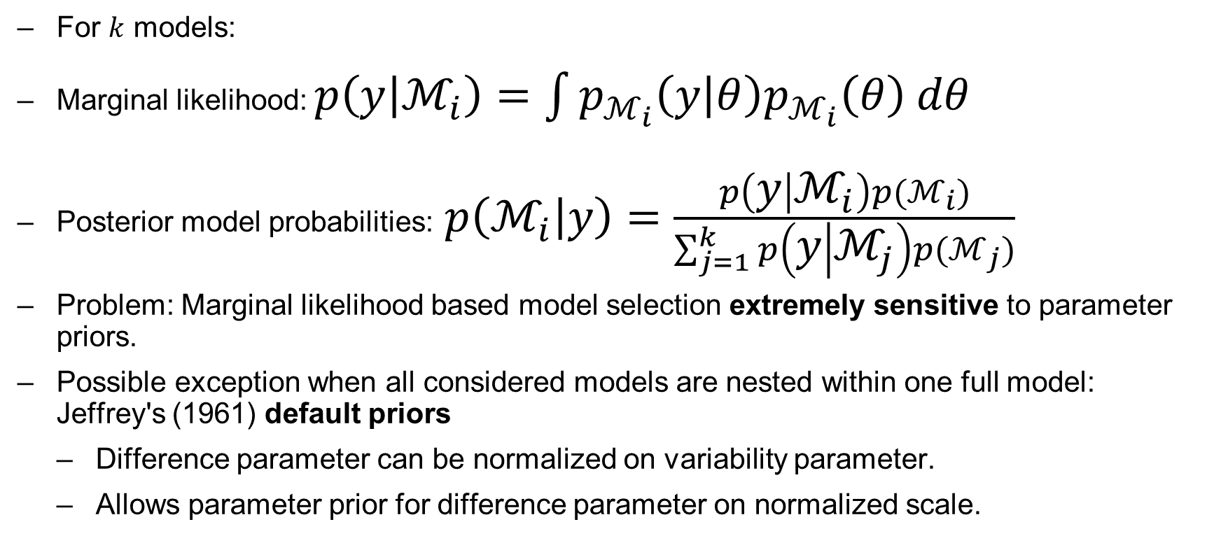
Bayesian Model Selection II
For $k$ models:
Marginal likelihood: $p\left(y | ℳ_{i}\right)=\int{p_{ℳ_{i}}\left(y | θ\right)p_{ℳ_{i}}\left(θ\right) dθ}$
Posterior model probabilities:$p\left(ℳ_{i} | y\right)=\frac{p\left(y | ℳ_{i}\right)p(ℳ_{i})}{\sum_{j=1}^{k}{p\left(y | ℳ_{j}\right)p(ℳ_{j})}}$
Problem: Marginal likelihood based model selection extremely sensitive to parameter priors.
Possible exception when all considered models are nested within one full model: Jeffrey's (1961) default priors
Difference parameter can be normalized on variability parameter.
Allows parameter prior for difference parameter on normalized scale.

Slide 7
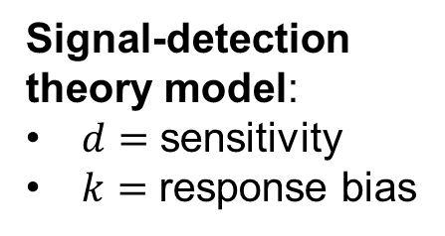
SDT with 2 Groups: 4 Possible Models
Two groups: low WM capacity and high WM capacity
No differences between groups: $d_{low}=d_{high}$, $k_{low}=k_{high}$
Groups differ only in sensitivity: $d_{low}≠d_{high}$, $k_{low}=k_{high}$
Groups differ only in response bias: $d_{low}=d_{high}$, $k_{low}≠k_{high}$
Groups differ in both, sensitivity and response bias: $d_{low}≠d_{high}$, $k_{low}≠k_{high}$
Model selection:
Posterior model probabilities
40%
45%
8%
7%
Signal-detection theory model:
$d=$ sensitivity
$k=$ response bias
"L"
"T"
lure
target
signal strength

Slide 8
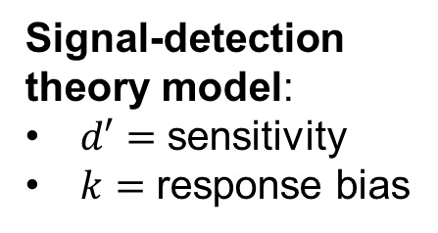
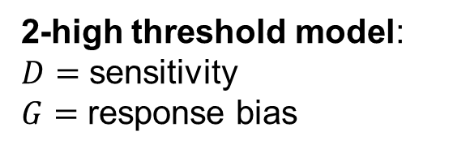
Signal Detection Theory Model and 2-High Threshold Model
2-high threshold model:
$D=$ sensitivity
$G=$ response bias
"T"
Signal-detection theory model:
$d′=$ sensitivity
$k=$ response bias
$$D$$
"L"
"T"
target
"T"
$$G$$
$$1−D$$
lure
target
lure
$$1−G$$
"L"
$$D$$
"L"
signal strength

Slide 9
Signal Detection Theory Model and 2-High Threshold Model
Two groups: low WM capacity and high WM capacity
No differences between groups
Groups differ only in sensitivity
Groups differ only in response bias
Groups differ in both, sensitivity and response bias
30%
40%
$D_{low}=D_{high}$, $g_{low}=g_{high}$
$d_{low}^{′}=d_{high}^{′}$, $k_{low}=k_{high}$
25%
45%
$D_{low}≠D_{high}$, $g_{low}=g_{high}$
$d_{low}^{′}≠d_{high}^{′}$, $k_{low}=k_{high}$
$D_{low}=D_{high}$, $g_{low}≠g_{high}$
28%
8%
$d_{low}^{′}=d_{high}^{′}$, $k_{low}≠k_{high}$
$D_{low}≠D_{high}$, $g_{low}≠g_{high}$
17%
7%
$d_{low}^{′}≠d_{high}^{′}$, $k_{low}≠k_{high}$
2-high threshold model:
$D=$ sensitivity
$G=$ response bias
"T"
Signal-detection theory model:
$d′=$ sensitivity
$k=$ response bias
$$D$$
"L"
"T"
target
"T"
$$G$$
$$1−D$$
lure
target
lure
$$1−G$$
"L"
$$D$$
"L"
signal strength

Slide 10
Signal Detection Theory Model and 2-High Threshold Model
Ensemble Posterior Model Probabilities
Two groups: low WM capacity and high WM capacity
No differences between groups
Groups differ only in sensitivity
Groups differ only in response bias
Groups differ in both, sensitivity and response bias
30%
35%
40%
$D_{low}=D_{high}$, $g_{low}=g_{high}$
$d_{low}^{′}=d_{high}^{′}$, $k_{low}=k_{high}$
25%
35%
45%
$D_{low}≠D_{high}$, $g_{low}=g_{high}$
$d_{low}^{′}≠d_{high}^{′}$, $k_{low}=k_{high}$
$D_{low}=D_{high}$, $g_{low}≠g_{high}$
28%
18%
8%
$d_{low}^{′}=d_{high}^{′}$, $k_{low}≠k_{high}$
$D_{low}≠D_{high}$, $g_{low}≠g_{high}$
17%
12%
7%
$d_{low}^{′}≠d_{high}^{′}$, $k_{low}≠k_{high}$
2-high threshold model:
$D=$ sensitivity
$G=$ response bias
"T"
Signal-detection theory model:
$d′=$ sensitivity
$k=$ response bias
$$D$$
"L"
"T"
target
"T"
$$G$$
$$1−D$$
lure
target
lure
$$1−G$$
"L"
$$D$$
"L"
signal strength

Slide 11
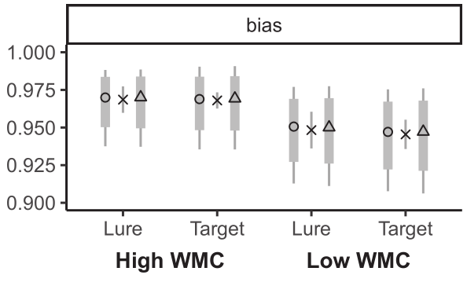
Example Experiment: WM Capacity and Detection Performance
m
Study List
r
b
Accuracy
500 ms each
v
#&#
v
y
Threshold Model
T
L
T
L
Observed Data
target
lure
Signal-Detection Model

Slide 12
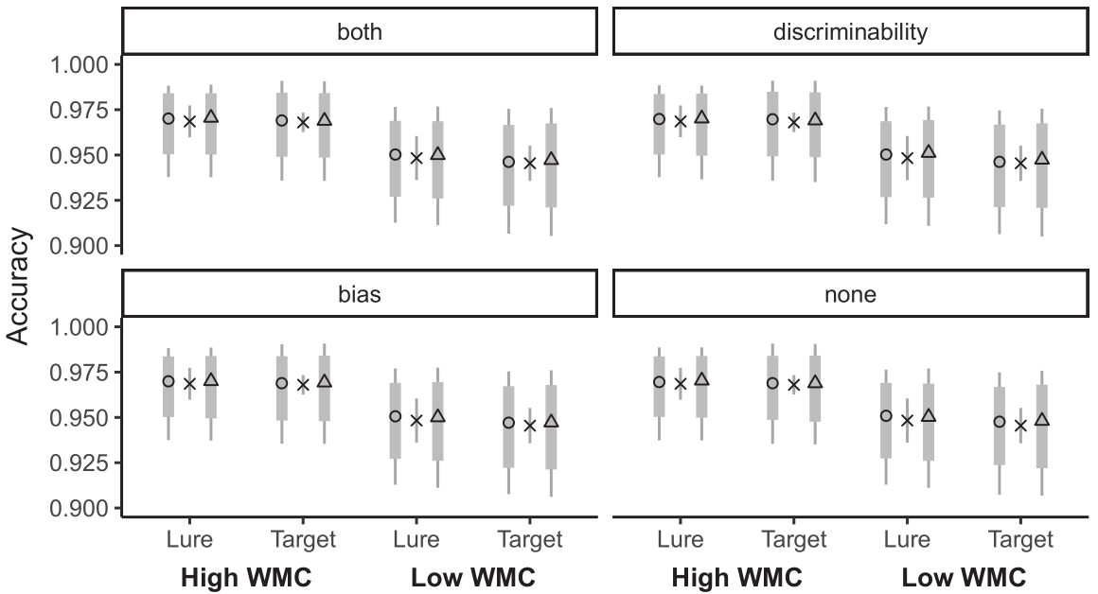
Threshold Model
Observed Data
Signal-Detection Model

Slide 13
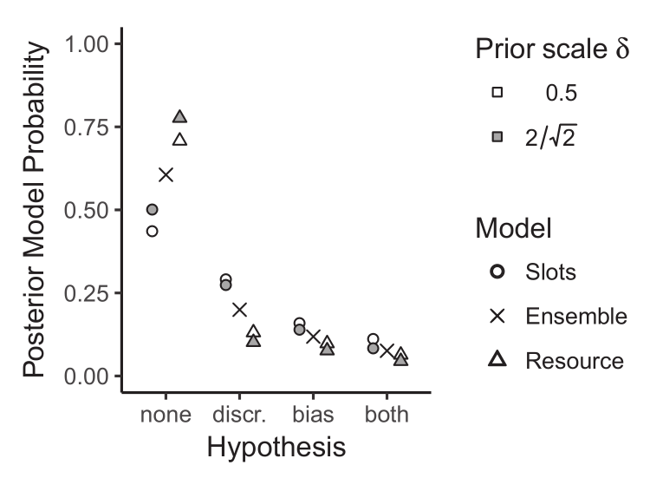
Example Experiment: Ensemble Posterior Model Probabilities
Threshold Model
Signal-Detection Model

Slide 14
Ensemble Posterior Model Probabilities
"All models are wrong" (Box, 1976).
Substantive conclusion should be as model independent as possible.
Different model classes decompose data into same latent cognitive processes.
Ensemble posterior model probabilities allow inferences regarding substantive questions across ensembles of model classes.
Why not simply estimate posterior model probabilities across model classes?
Marginal likelihood based model selection extremely sensitive to parameter priors.
Parameter priors mostly play auxiliary or nuisance role.
Difficult or often impossible to come up with parameters priors which allow model selection in a fair manner (but see Lee & Vanpaemel, 2017; Vanpaemel & Lee, 2012).
Marginal likelihood based model selection using Jeffrey's default priors within model class sidesteps many of these problems.

