Slide 1
Assumption Violations in Forced-Choice Recognition Judgments Implications from the Area Theorem
David Kellen, Henrik Singmann, Sharon Chen, and Samuel Winiger

Slide 2
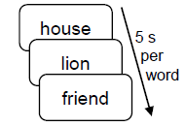
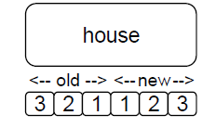
Study list
Old item
New item
lion
sea
One challenge in recognition-memory research is disentangling discriminability and response biases:
Discriminability: How well can one distinguish between old and new items?
Response bias: What is one’s overall tendency to answer «old»?

Slide 3
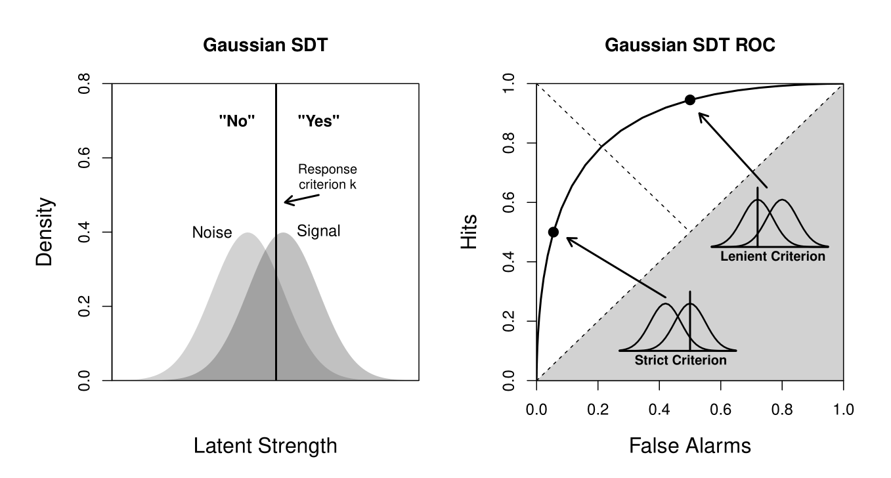
Signal Detection Theory (SDT) provides a solution to this problem
Old-New ROC
Latent strength / familiarity

Slide 4
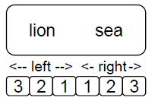
In order to sidestep the issue of response bias, researchers often rely on a two-alternative forced choice (2-AFC) paradigm:
Left Item Old

Slide 5
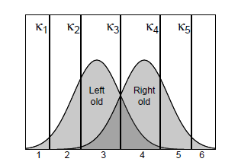
SDT assumes that individuals evaluate difference between two options.
Traditional assumption: Individuals choose most familiar option (MAX rule)
Left Item Old
Right-Left Difference

Slide 6
Old/new and 2-AFC judgments are connected by the Area Theorem:
Proportion of correct 2-AFC judgments (when applying MAX rule) corresponds to area under old-new ROC.
This prediction is non-parametric.

Slide 7
Some researchers question empirical accuracy of Area Theorem (Hockley et al., 1984; Jou et al., 2016; Starns et al., 2017)
They argue that in some 2-AFC trials, individuals make response based on first item they process (most often left one).
If this is generally true, then Area Theorem should be violated.
This situation would upend SDT implementations in many domains such as eyewitness testimony.

Slide 8
Goal of present work is to check whether one can observe violations of Area Theorem.
To do this, we will analyze 63 participants from Jang, Wixted, and Huber (2009).

Slide 9
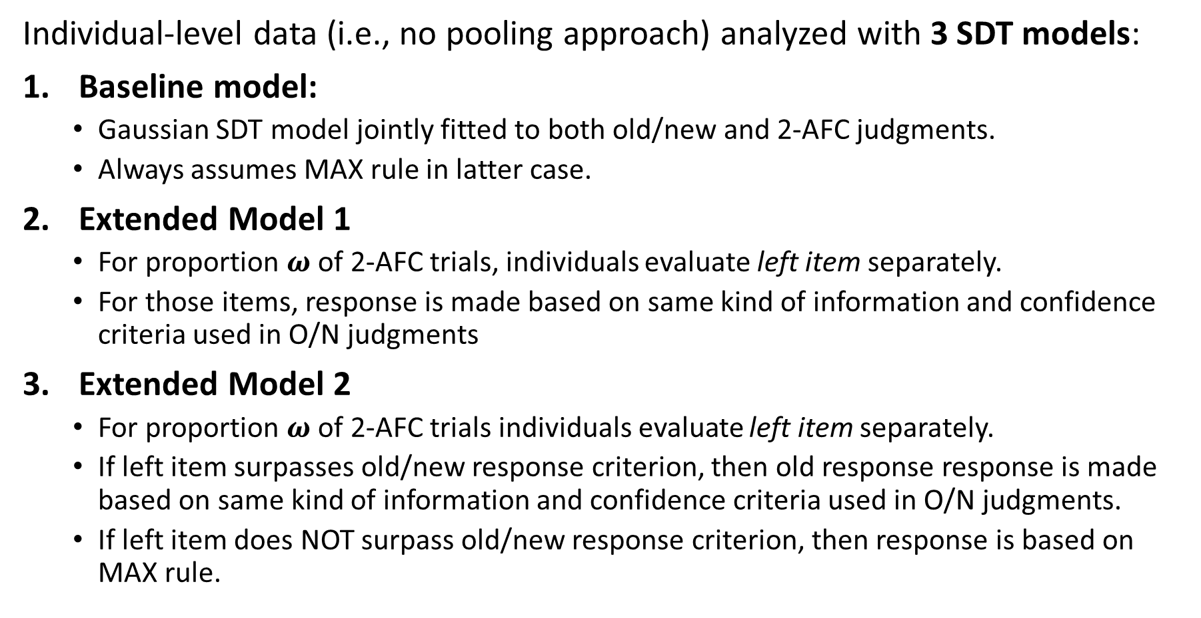
Individual-level data (i.e., no pooling approach) analyzed with 3 SDT models:
Baseline model:
Gaussian SDT model jointly fitted to both old/new and 2-AFC judgments.
Always assumes MAX rule in latter case.
Extended Model 1
For proportion $ω$ of 2-AFC trials, individuals evaluate left item separately.
For those items, response is made based on same kind of information and confidence criteria used in O/N judgments
Extended Model 2
For proportion $ω$ of 2-AFC trials individuals evaluate left item separately.
If left item surpasses old/new response criterion, then old response response is made based on same kind of information and confidence criteria used in O/N judgments.
If left item does NOT surpass old/new response criterion, then response is based on MAX rule.

Slide 10
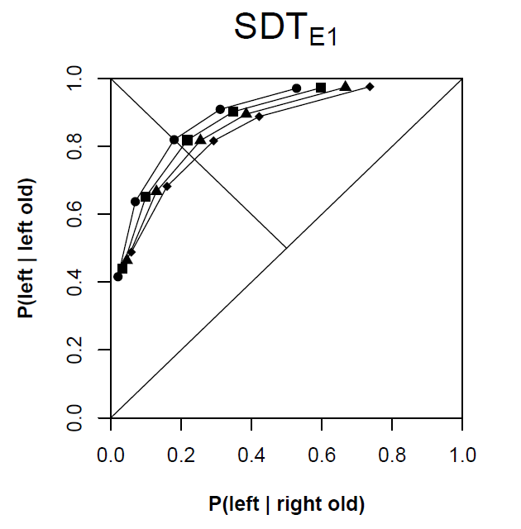
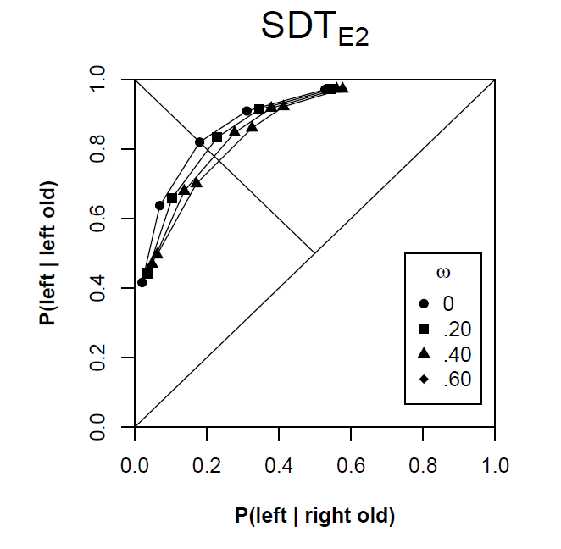
Contamination of 2-AFC judgments with old/new judgments is expected to reduce 2AFC performance and distort 2-AFC ROC.

Slide 11
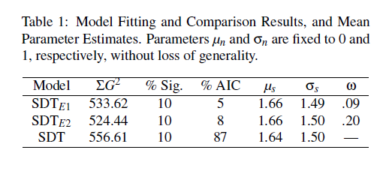
All models were fit to individual-level data using maximum-likelihood.
Difference in summed misfit was not siginificant (both p > .43)

Slide 12
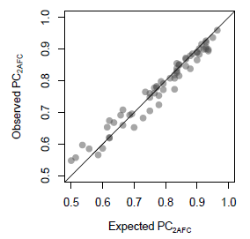
Baseline model gave a good account of 2-AFC performance.

Slide 13
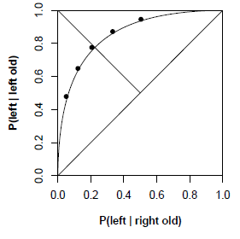
In fact, baseline model was able to make very good predictions regarding 2-AFC performance based on old/new judgments alone
line: predicted 2AFC ROC from fit to old/new data
points: observed 2AFC data

Slide 14
We conducted a power analysis using semi-parametric bootstrap:
1 – generate bootstrap sample from individual data
2 – fit with extended model
3 – set w=.20 and generate new data
4 – compute difference in fit between baseline and extended models
5 – Repeat steps 1 to 4 for each participant and compute summed difference in fit (and p-value)
6 – Repeat 1-5 1000 times.
For both models, statistical power (for α = .05) was .97 and .99.

Slide 15
Previous work (e.g., Hockley, 1984; Jou et al., 2016; Starns et al., 2017) reported evidence suggesting that SDT assumption of MAX rule are violated.
However, none of these studies fitted a model that directly captured assumption violations.
Present results show that baseline SDT model provides good account of data, providing no support for old/new contamination of 2AFC data.

Slide 16
We collected new data in which tested Generalized Area Theorem.
According to this theorem, proportion of correct judgments in an m-AFC task is an estimate of (m-1)th moment of old-new ROC.
This means that we can construct old-new ROC based on forced-choice judgments alone and compare it with old/new judgments.

Slide 17
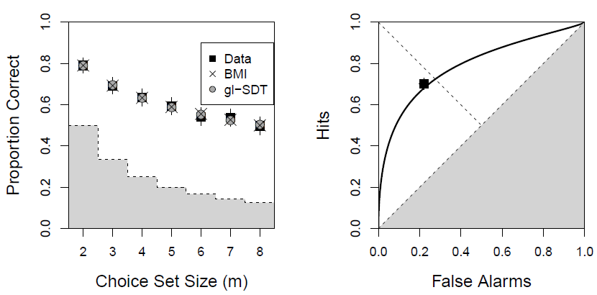
We collected data from 103 participants online (via Figure-Eight).
After study phase, each participant responded to old/new trials and m-AFC trials, from m=2 to m=8 (5 trials each)

Slide 18
Thank you.

Slide 19
Other Studies
Starns et al., 2017
Eye-tracking study with words relatively far apart
Cost for participants (time) for considering both word in each trial.
Jou et al., 2016
Semantically related distractors, not base paradigm

