Slide 1
Neither Measurement Error nor Speed-Accuracy Trade-Offs Explain the Difficulty of Establishing Attentional Control as a Psychometric Construct: Evidence from a Latent-Variable Analysis using Diffusion Modelling
https://psyarxiv.com/3h26y/
Henrik Singmann¹, Alodie Rey-Mermet²,
& Klaus Oberauer³
¹ UCL, ² UniDistance Suisse, ³ University of Zurich

Slide 2
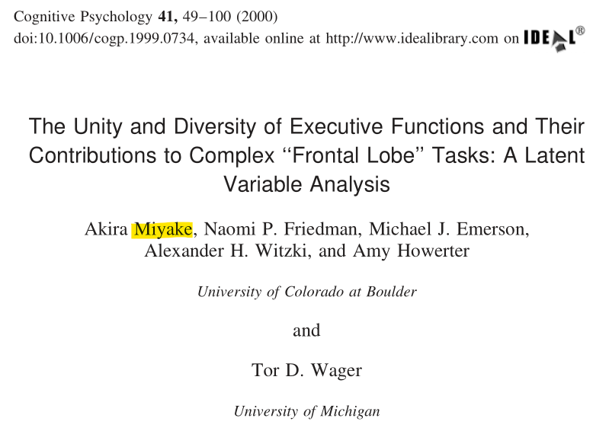
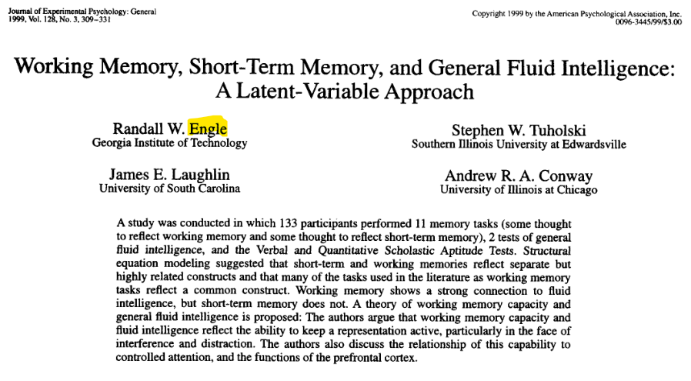
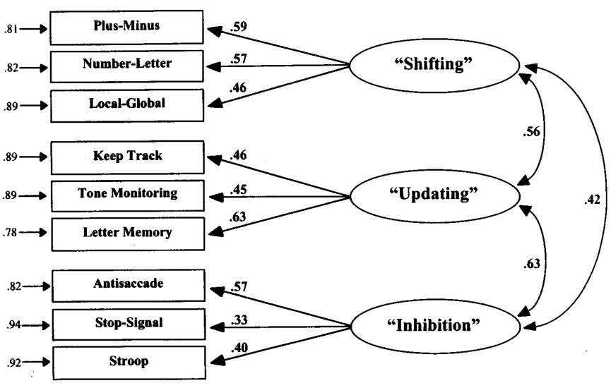
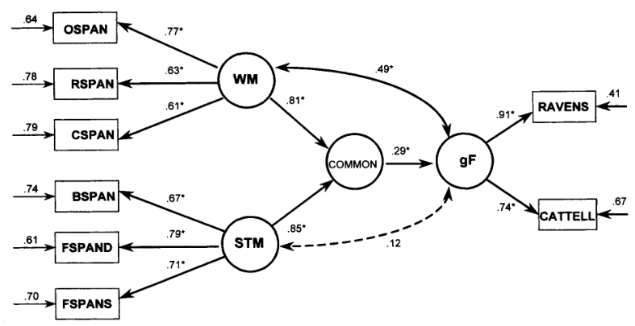
Notes:
- Established attentional control (cognitive control, executive control, executive attention, or executive functions): ability to maintain and implement a goal and goal-relevant information in the face of distraction

Slide 3
> 4k citations
> 18k citations
attentional control as psychometric construct
Notes:
Established attentional control (cognitive control, executive control, executive attention, or executive functions): ability to maintain and implement a goal and goal-relevant information in the face of distraction
In recent years, failure to replicate relationship among congruency effects in conflict tasks

Slide 4
Conflict Tasks
Each trial contains goal relevant and irrelevant information. Irrelevant information can be congruent or incongruent with relevant information.
Congruency effect: performance difference between congruent and incongruent trials (RTs or error rate)
Stroop task: Name colour in which word is written
Congruent: red
Incongruent: green

Slide 5
Methodological Limitations
Recent failures of finding coherent attentional control construct in conflict tasks might be due to:
neglect of individual differences in speed-accuracy trade-offs when only speed or accuracy is used as dependent variable
large measurement error and low reliability of attentional-control measures
use of difference measures to assess attentional control

Slide 6
Research Question
Research question: Can we establish psychometric construct of attentional control when methodological limitations are overcome?
Our approach:
Reanalysis of 5 data sets
2 data sets from Rey-Mermet et al. (2018) with 8 conflict tasks, N = 120 & 143, ≈ 150 trials per task
3 data sets from Whitehead et al. (2019) with 3 conflict tasks, N = 178 to 210, ≈ 700 trials per task
Hierarchical-Bayesian 4-parameter diffusion model: can be applied to all cognitive tasks
Focus on drift rate: ability to control attention in congruent vs. incongruent trials
Estimate correlation matrix of drift rate parameters (using either difference coding or condition coding) with non-informative LKJ prior
Second step: posterior distribution of correlation matrix for calculation of SEMs

Slide 7
Addressing Methodological Limitations
neglect of individual differences in speed-accuracy trade-offs when only speed or accuracy is used as dependent variable
Diffusion model automatically accounts for speed-accuracy trade-offs
large measurement error and low reliability of attentional-control measures
Lower error on trial-level: Diffusion model adequately describes response time distribution
Lower error on individual-level: Partial pooling through hierarchical-Bayesian approach
Lower error on correlation: Correlation matrix – basis of SEM – parameter in model (less error accumulation)
Lower error overall: 4-parameter model strikes good balance between bias and variance
use of difference measures to assess attentional control
Two different SEM approaches:
Difference coding approach: model drift rate difference between congruent and incongruent trials
Condition coding approach: bifactor model on congruency condition specific drift rate

Slide 8
Results
Exemplary present weakest and strongest converged data sets and models
Weakest result (worst fit and lowest correlations): Rey-Mermet et al. (2018) – Younger Adults – Difference Coding
Strongest result (best fit and largest correlations): Whitehead et al. 2019 - Exp. 2 – Difference Coding
For each data set and model:
Model fit
Drift rate correlations
SEM results

Slide 9
Model fit (posterior predictive distribution): Rey-Mermet et al. (2018) – Younger Adults

Slide 10
Drift rate difference correlations: Rey-Mermet et al. (2018) – Younger Adults
Measure | Color Stroop | Number Stroop | Arrow flanker | Letter flanker | Simon | Local | Positive comp.
Color Stroop | -
Number Stroop | -.02 [-.30, .26] | -
Arrow flanker | -.14 [-.42, .17] | .03 [-.23, .30] | -
Letter flanker | -.09 [-.37, .21] | .10 [-.18, .37] | .26 [-.01, .51] | -
Simon | -.13 [-.40, .17] | .04 [-.18, .27] | .08 [-.15, .31] | .21 [-.04, .45] | -
Local | .11 [-.21, .39] | .03 [-.25, .32] | .06 [-.22, .34] | .09 [-.21, .36] | .19 [-.08, .44] | -
Positive comp. | -.02 [-.31, .27] | .03 [-.22, .28] | .00 [-.25, .25] | .16 [-.11, .41] | .11 [-.11, .33] | .07 [-.21, .35] | -
Negative comp. | -.04 [-.32, .23] | .16 [-.10, .41] | .06 [-.20, .33] | .12 [-.16, .37] | .02 [-.21, .25] | .04 [-.23, .30] | .09 [-.15, .35]

Slide 11
SEM on posterior mean correlation matrix: Rey-Mermet et al. (2018) – Younger Adults

Slide 12
Model fit: Whitehead et al. (2019) – Experiment 2

Slide 13
Drift rate difference correlations: Whitehead et al. (2019) – Experiment 2
Measure | Color Stroop | Spatial Stroop
Color Stroop | -
Spatial Stroop | .20 [.01, .39] | -
Flanker | .14 [-.10, .38] | .31 [.08, .52]

Slide 14
SEM on posterior mean correlation matrix: Whitehead et al. (2019) – Experiment 2
$ω$ (omega)

Slide 15
Results Overview
Dataset | Drift rate with difference coding | Drift rate with condition coding | Boundary separation | Non-decision time
1 | No coherent factor of attentional control | No coherent factor of attentional control | A coherent factor | No factor
2 | No factor of attentional control | No coherent factor of attentional control | No factor | A moderately coherent factor
3 | No factor of attentional control | No factor of attentional control | A coherent factor | A coherent factor
4 | No coherent factor of attentional control | No coherent factor of attentional control | A coherent factor | A moderately coherent factor
5 | No coherent factor of attentional control | No coherent factor of attentional control | A coherent factor | A coherent factor

Slide 16
Summary
Preprint: https://psyarxiv.com/3h26y/
Is there a general attentional control construct?
Possibly no:
Recent results question conclusions by Miyake et al. (2000) and Engle et al. (1999) (e.g., Karr et al., 2018, Psychol Bull; Rey-Mermet et al., 2019, JEP:Gen; Rey-Mermet et al., 2020, PlosOne; von Bastian et al., 2020, PsyArXiv).
Even with relatively fancy statistical methods there is extremely little evidence for a coherent attentional control construct.
Possibly yes:
Our data is not yet strong enough: reliability too low, too few participants, wrong statistical model (e.g., work by Rouder, Haaf, et al.)
The bigger picture
Claims for general psychological constructs require strong evidence (see also work on risk preferences: Pedroni et al., 2017; Frey et al., 2017)
Maybe methods for uncovering structures in covariance matrices (e.g., FA, SEM) are not appropriate tools for “carving nature at its joints”

Slide 17
Results Overview
Dataset | Drift rate with difference coding | Drift rate with condition coding | Boundary separation | Non-decision time
1 | No coherent factor of attentional control | No coherent factor of attentional control | A coherent factor | No factor
2 | No factor of attentional control | No coherent factor of attentional control | No factor | A moderately coherent factor
3 | No factor of attentional control | No factor of attentional control | A coherent factor | A coherent factor
4 | No coherent factor of attentional control | No coherent factor of attentional control | A coherent factor | A moderately coherent factor
5 | No coherent factor of attentional control | No coherent factor of attentional control | A coherent factor | A coherent factor

Slide 18
Model fit: Rey-Mermet et al. (2018) – Younger Adults

Slide 19
Model fit: Whitehead et al. (2019) – Experiment 2

Slide 20
DOWNLOAD SLIDES
Thank you for your attention!
Contact: alodie.rey-mermet@fernuni.ch

