Slide 1
Suppression Effects in the Dual-Source Model of Conditional Reasoning
Henrik Singmann
Karl Christoph Klauer
Sieghard Beller

Slide 2
Conditional Reasoning
A conditional is a rule with the form: If p, then q.
Conditional inferences usually consist of the conditional rule (major premise), a minor premise (e.g., p) and the conclusion (e.g., q). e.g.:
If a person drinks a lot of coke, then the person will gain weight.
A person drinks a lot of coke.
Conclusion: The person will gain weight.

Slide 3
4 Conditional Inferences
Modus Ponens (MP):
If p, then q.
p
Conclusion: q
Affirmation of the consequent (AC):
If p, then q.
q
Conclusion: p
Modus Tollens (MT):
If p, then q.
Not q
Conclusion: Not p
Denial of the antecedent (DA):
If p, then q.
Not p
Conclusion: Not q

Slide 4
4 Conditional Inferences
Modus Ponens (MP):
If p, then q.
p
Conclusion: q
Affirmation of the consequent (AC):
If p, then q.
q
Conclusion: p
Modus Tollens (MT):
If p, then q.
Not q
Conclusion: Not p
Denial of the antecedent (DA):
If p, then q.
Not p
Conclusion: Not q
valid in standard logic (i.e., truth of premises entails truth of conclusion)
NOT valid in standard logic (i.e., truth of premises does NOT entail truth of conclusion)

Slide 5
Content Effects
Content can influence reasoning from conditionals via two types of counterexamples: disabling conditions and alternative antecedents.
If a balloon is pricked with a needle, then it will quickly lose air.
Few disablers for the consequent and many alternatives for the antecedent lead to strong endorsement of valid inferences (MP & MT) and weak endorsement of the invalid inferences (AC & DA)
If a girl has sexual intercourse, then she will be pregnant.
Many disablers for the consequent and few alternatives for the antecedent lead to weak endorsement of valid inferences (MP & MT) and strong endorsement of the invalid inferences (AC & DA)
To tap everyday reasoning studies often use probabilistic instructions: "How likely is it that the conclusion holds?"

Slide 6
Explaining content effects
Probabilistic theory (Oaksford et al., 2000)
Reasoning is estimation of probabilities based on background knowledge of the problem.
Problem Type | MP | MT | AC | DA
 | p → q p : q | p → q ¬q : ¬p | p → q q : p | p → q ¬p : ¬q
Response reflects | P(q|p) | P(¬p|¬q) | P(p|q) | P(¬q|¬p)

Slide 7
Explaining content effects
Probabilistic theory (Oaksford et al., 2000)
Reasoning is estimation of probabilities based on background knowledge of the problem.
What is the effect of the rule? (e.g. Liu, 2003)
Typically endorsement of MP and MT is heightend
Problem Type | MP | MT | AC | DA
 | p : q | ¬q : ¬p | q : p | ¬p : ¬q
Response reflects | P(q|p) | P(¬p|¬q) | P(p|q) | P(¬q|¬p)

Slide 8
The Dual-Source Model
The dual-source model is a mathematical measurement model that describes probabilsitic conditional reasoning with three parameters:
ξ (xsi): quantifies the knowledge-based component (formalized as in Oaksford et al.'s, 2000, model)
τ (tau): form-based evidence
λ (lambda): weighting factor
According to the dual-source model (Klauer, Beller, & Hütter, 2010) the effect of the rule is to provide (form-based) evidence in addition to background knowledge.

Slide 9
The dual-source model
Observable response on one inference = λ{τ(x) × 1 + (1 – τ(x)) × ξ(C,x)} + (1 – λ)ξ(C,x)
τ(x) = form-based evidence, subjective probability for accepting inference x (i.e., MP, MT, AC, DA) based on the logical form.
ξ(C,x) = knowledge-based evidence, subjective probability for accepting inference x for content C based on the background knowledge.

Slide 10
Estimating the dual-source model
Participants work on conditional reasoning tasks with different contents on two sessions:
First session: Problems without conditional rule.
Second session: Problems with conditional rule.
Four contents cross disablers and alternatives:
If a predator is hungry, then it will search for prey. (few disablers, few alternatives)
If a person drinks a lot of coke, then the person will gain weight. (many disablers, many alternatives)
If a balloon is pricked with a needle, then it will quickly lose air. (few disablers, many alternatives)
If a girl has sexual intercourse, then she will be pregnant. (many disablers, few alternatives)

Slide 11
Estimating the dual-source model
In both sessions participants work on all 4 contents and all four conditional inferences (MP, MT, AC, DA)
To obtain better estimates of the perceived probability with which a conclusion holds, participants work on two versions of each inference, the original conclusion and the converse conclusion:
MP (Original): p → q; p : q
MP' (Converse): p → q; p : ¬q
The model is fitted by minimizing the sum of the squared deviance from data and predictions with a linear weighting function for consistent answers (i.e., if original and converse responses sum to 100, weight is 1)

Slide 12
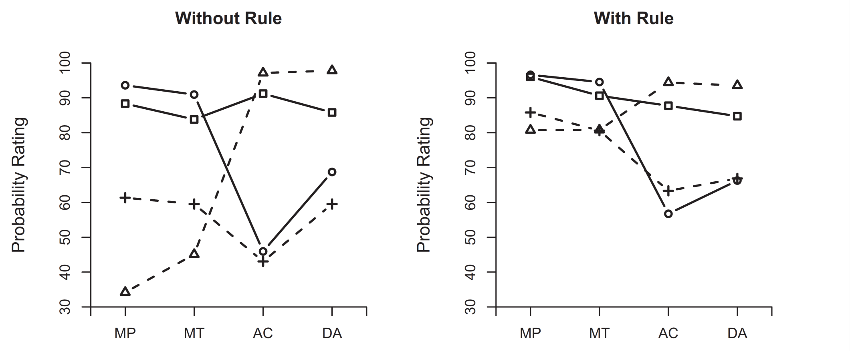
Klauer et al. (2010): Exp 1
predator: few disablers, few alternatives
balloon: few disablers, many alternatives
girl: many disablers, few alternatives
coke: many disabler, many alternatives

Slide 13
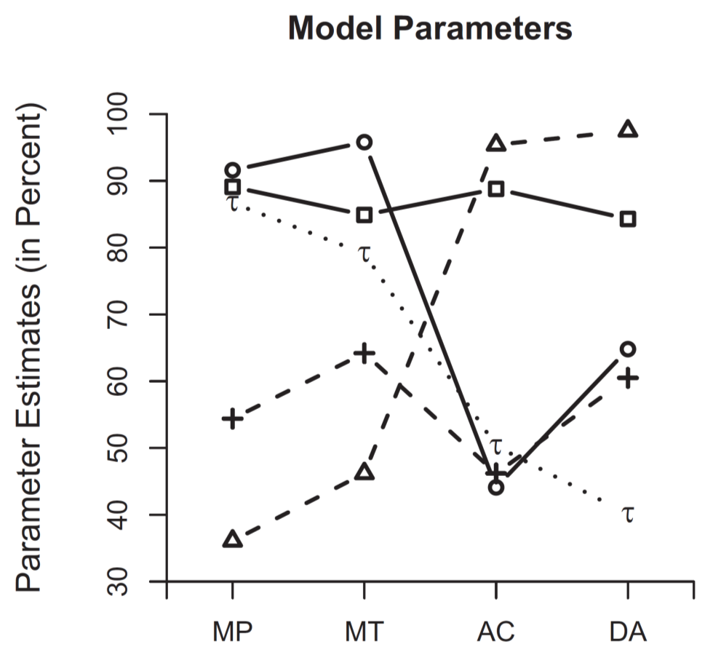
Klauer et al. (2010): Exp 1
R² = .88; λ = .40
predator: few disablers, few alternatives
balloon: few disablers, many alternatives
girl: many disablers, few alternatives
coke: many disabler, many alternatives

Slide 14
Suppression effects (Byrne, 1989) *
Counterexamples (disablers and alternatives) implicitly influence endorsement to inferences.
Byrne (1989) showed that additional premises with explicit counterexamples defeat otherwise valid inferences (i.e., human reasoning is non-monotonic)
If a girl has sexual intercourse, then she will be pregnant.
A girl has sexual intercourse.
How likely is it that she will be pregnant?
If a girl has sexual intercourse, then she will be pregnant.
A girl has sexual intercourse.
How likely is it that she will be pregnant?
Please note:
A girl is only pregnant, if she does not use contraceptives.

Slide 15
Suppression Effects: Exp. 1
Research question: Which parameters are affected by suppression effects?
Participants work on original and converse conditional inferences (4 contents) in two phases:
knowledge phase: without rule
rule phase: with rule
Three conditions:
baseline (no explicit counterexamples), n = 26
disablers (three additional disablers), n = 27
alternatives (three additional alternatives), n = 24

Slide 16
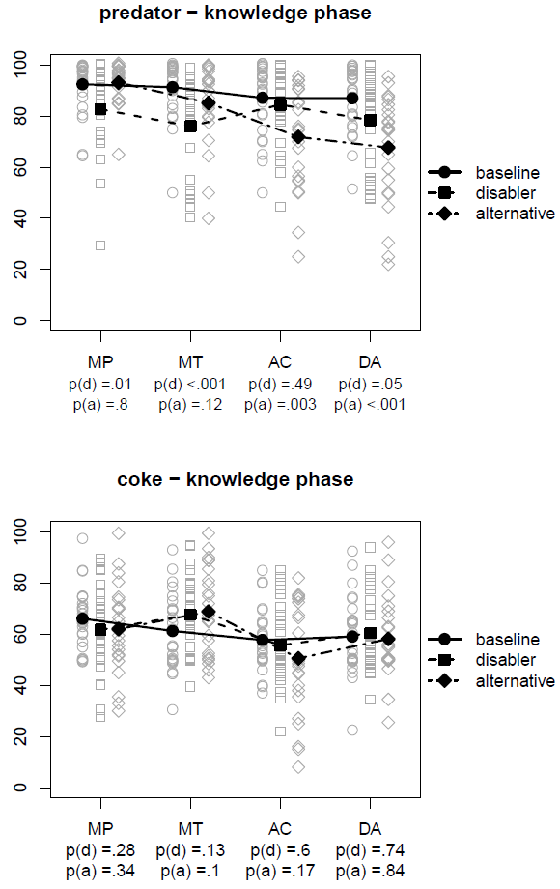
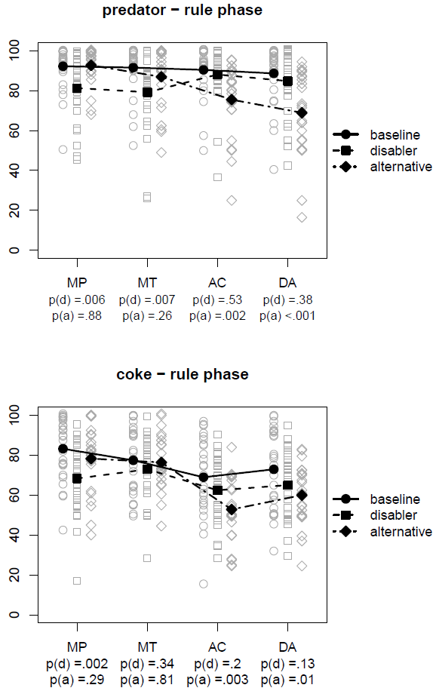

Slide 17
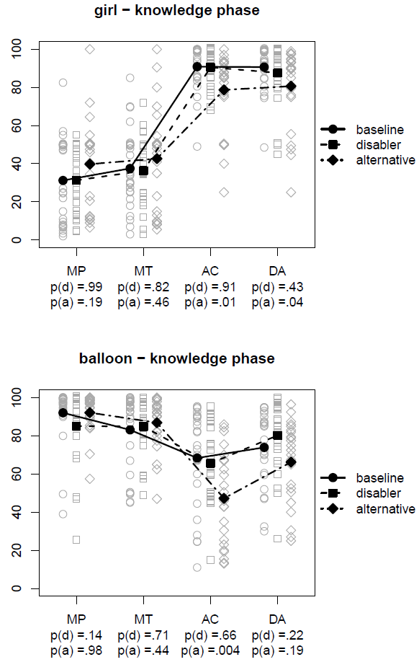
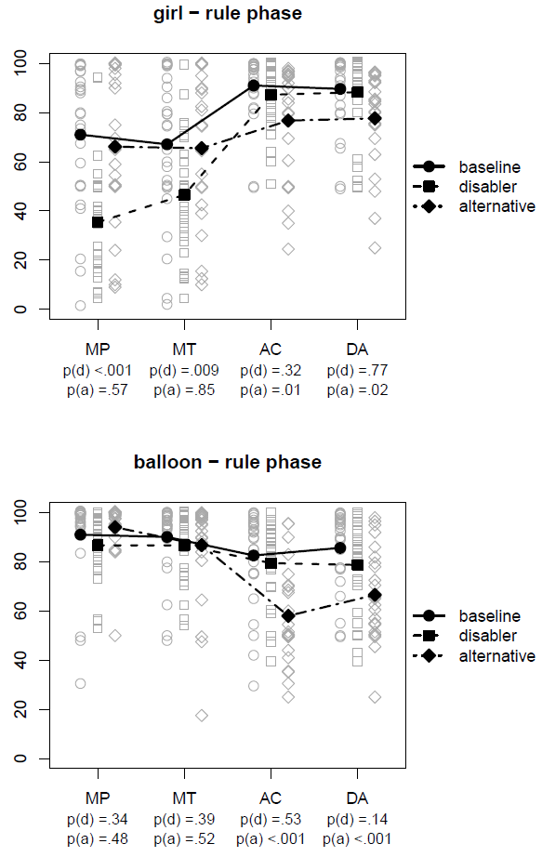

Slide 18
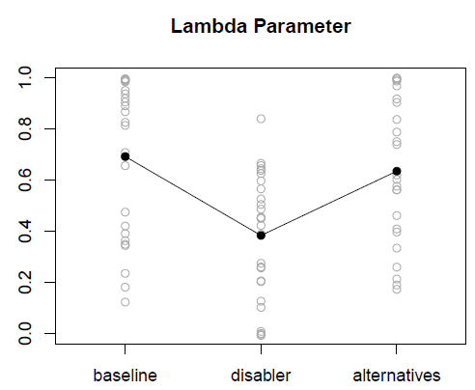
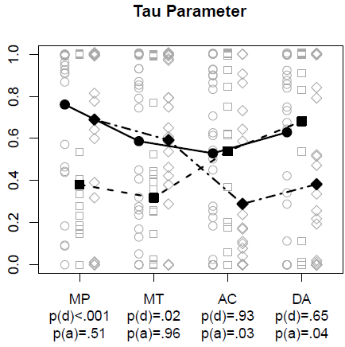
Fits, Weighting (λ), & Form (τ)
Model fit is good (R² = 0.91), no difference between conditions
***

Slide 19
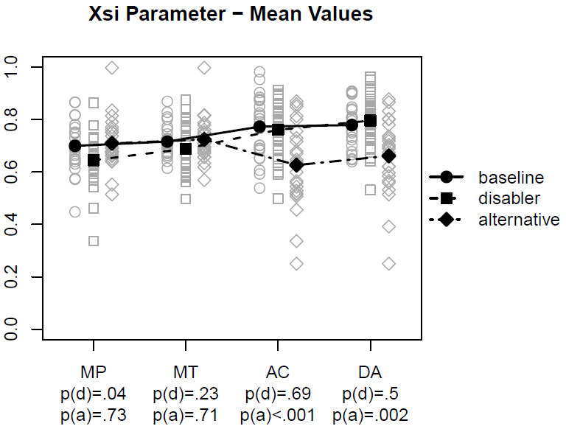
Knowledge Paramaters (Xsi)
3-way interaction of condition × content × inference is not significant (p = .07), only the 2-way interaction of condition × inference (p < .001):

Slide 20
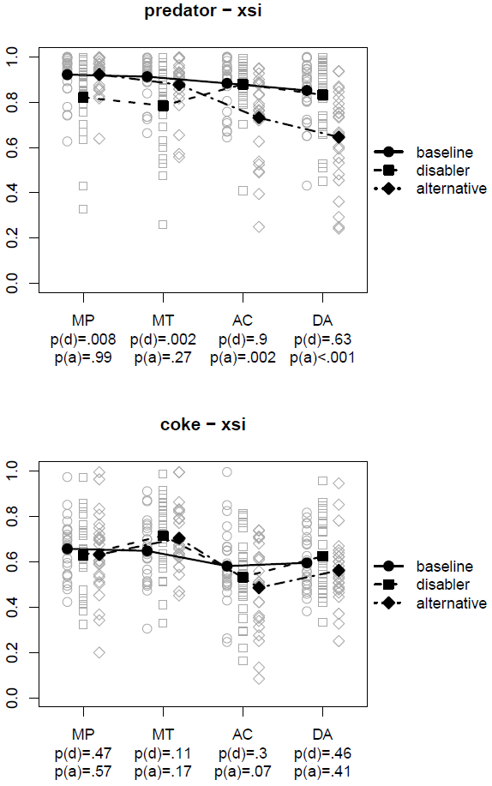
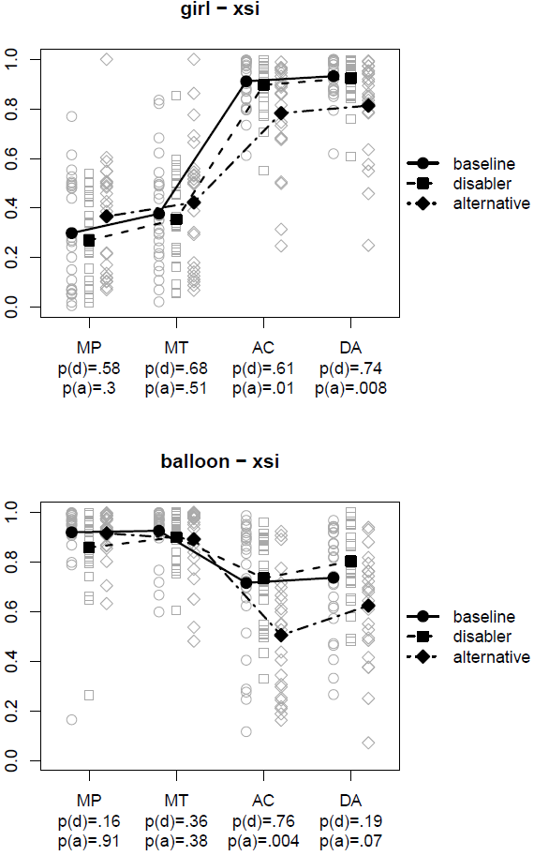

Slide 21
Suppression Effects - Experiment 1
The dual-source model shows a dissociation for different suppression effects:
Explicit disabling conditions
undermine the credibility of the rule: lower λ
undermine the perceived form-based evidence for the valid conditional inferences: lower τ(MP) and τ(MT)
Explicit alternative conditions
undermine the perceived form-based evidence for the invalid conditional inferences: lower τ(AC) and τ(DA)
undermine the perceived knowledge-based evidence for all contents on the invalid inferences: lower ξ(C, AC) and ξ(C, DA)

Slide 22
Supression Effects – Experiment 2
We asked 41 participants to generate either alternatives or disablers for the four contents and used the three most frequently generated counterexamples for the next study.
Participants work on original and converse conditional inferences(same 4 contents) in two phases:
knowledge phase: without rule
rule phase: with rule
Three experimental conditions:
baseline (no explicit counterexamples), n = 29
disablers (three additional disablers), n = 31
alternatives (three additional alternatives), n = 31
Six control conditions:
3 groups (baseline, …) with 2 knowledge phases (n = 92)
3 groups with only a rule phase (no prior knowledge phase) (n = 90)

Slide 23
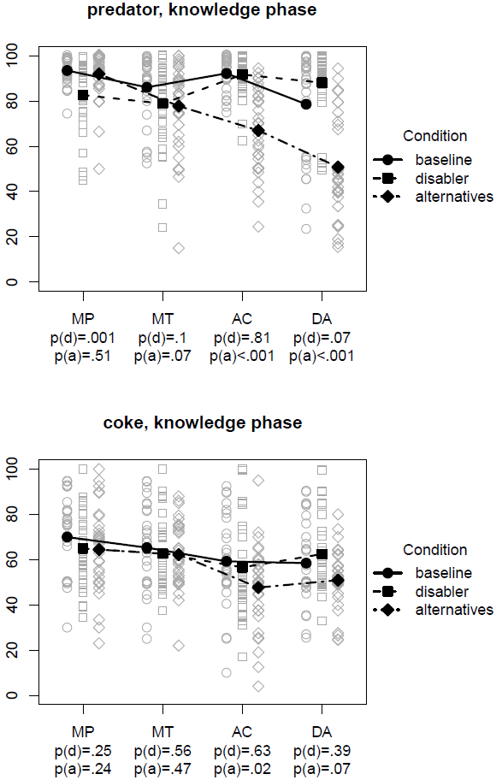
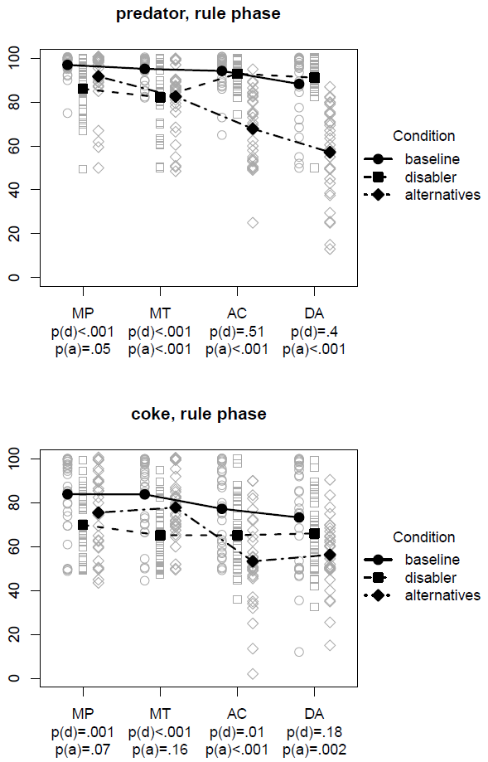

Slide 24
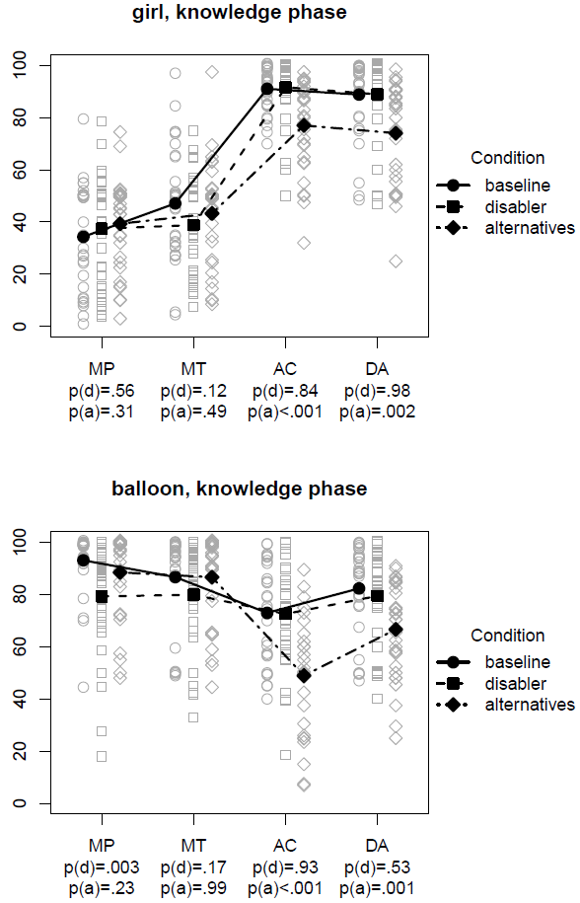
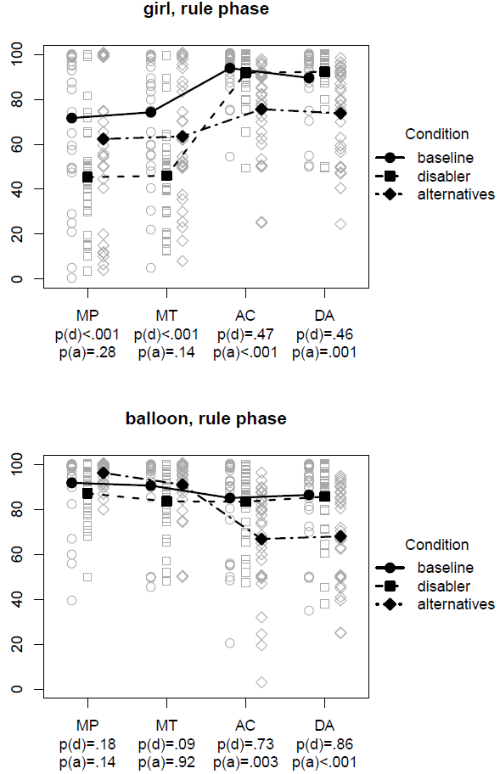

Slide 25
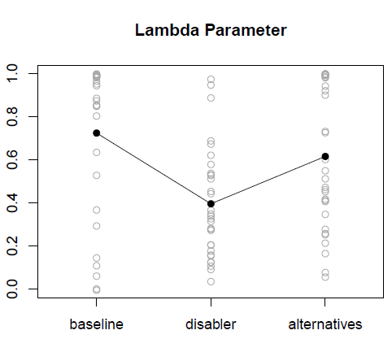
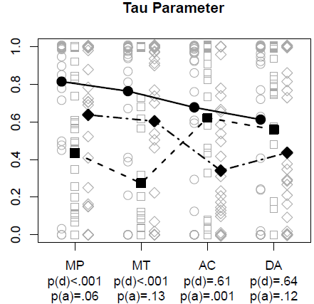
Fits, Weighting (λ), & Form (τ)
Model Fit was good (R² = .92), no differences between the conditions.
***

Slide 26
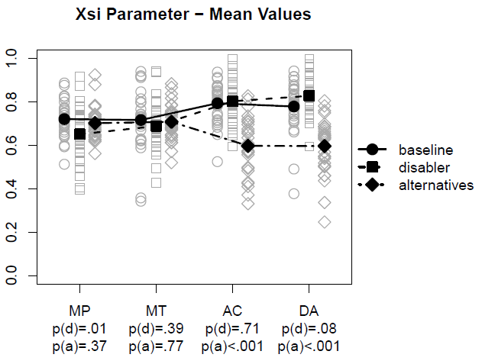
Knowledge Paramaters (Xsi)
3-way interaction of condition × content × inference is significant (p < .001), as well as the 2-way interaction of condition × inference (p < .001):

Slide 27
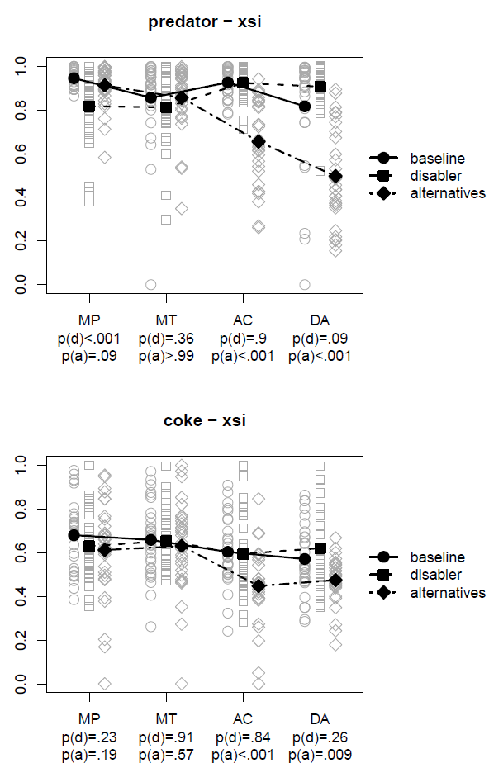
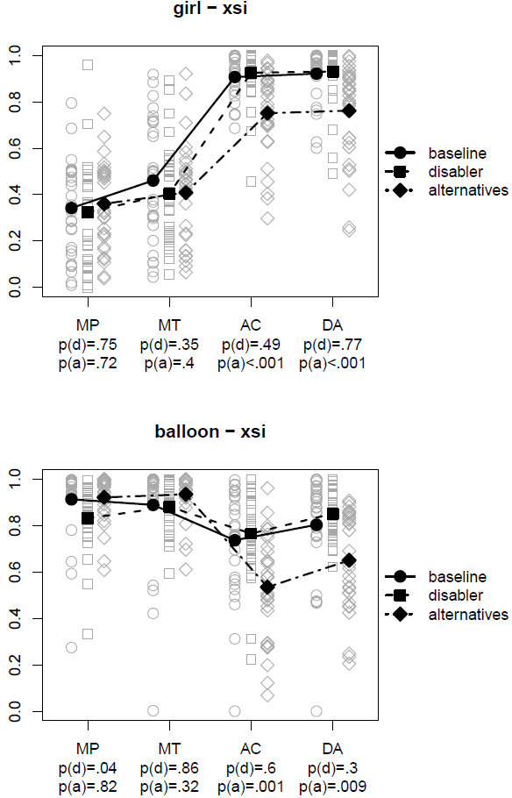

Slide 28
Suppression Effects - Experiment 2
The dual-source model shows a dissociation for different suppression effects (results replicate from experiment 1):
Explicit disabling conditions
undermine the credibility of the rule: lower λ
undermine the perceived form-based evidence for the valid conditional inferences: lower τ(MP) and τ(MT)
slight effects on knowledge parameter for MP: lower ξ(predator, MP) (replication)
Explicit alternative conditions
undermine the perceived form-based evidence for the invalid conditional problems: lower τ(AC) and τ(DA)
undermine the perceived knowledge-based evidence for all contents on the invalid inferences: lower ξ(C, AC) and ξ(C, DA)

Slide 29
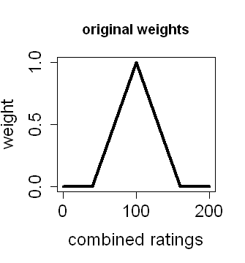
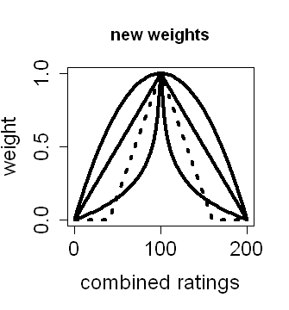
Consistency weighting: Exp. 2
The model is originally fitted with a linear weighting function truncated at 40 and 160 (Klauer et al. 2010). Original R² = .92
We fitted the model with a number of different weighting functions (without truncation) :
linear (R² = .89)
logarithmic (R² = .92)
quadratic (R² = .89)
The results hold between the different weighting functions

Slide 30
Summary
Modeling suppression effects with the dual-source model shows that both disabling conditions and alternative conditions suppress the subjective probability with which the relevant inferences seem warranted by the logical form of the inference (i.e., lower τ parameters).
Disabling condition suppress the credibility of the conditional rule (i.e., lower λ parameters).
Alternative antecedents suppress the subjective certainty that an inference seems warranted by background knowledge (i.e., lower ξ parameters).
Note that disablers and alternatives are confounded with causal direction.

Slide 31
Future research
The dual-source model is a robust method for decomposing the processes underlying probabilisitc conditional reasoning.
How do suppression effects and the causal direction interact?
How does speaker expertise affect the parameters of the dual-source model? (Stevens & Over, 2001)
Can the model be extended to other logical forms than conditional "if-then" rules? (Klauer et al. 2010, Exp. 3)
How do chronic and momentarily available cognitive ressources affect probabilistic conditional reasoning? (De Neys, Schaeken, d'Ydewalle, 2005)
Are there other ways of specifying or fitting the parameters of the dual-source model?

Slide 32
Thank you.

Slide 33
Control conditions Exp. 2
# | condition | Phase 1 | Phase 2
1 | baseline | without rule | with rule
2 | disabler | without rule | with rule
3 | alternative | without rule | with rule
4 | baseline | without rule | without rule
5 | disabler | without rule | without rule
6 | alternative | without rule | without rule
7 | baseline | with rule | nothing
8 | disabler | with rule | nothing
9 | alternative | with rule | nothing

